Slide 1
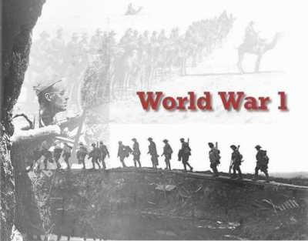
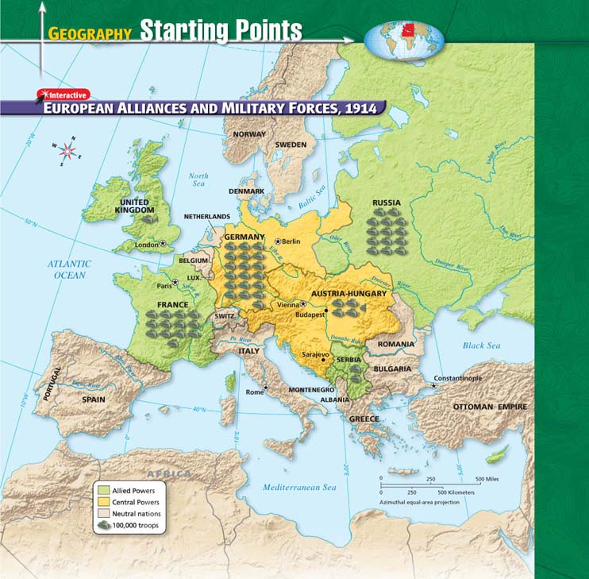
Government and Citizenship
GREAT WAR BEGINS

Slide 2
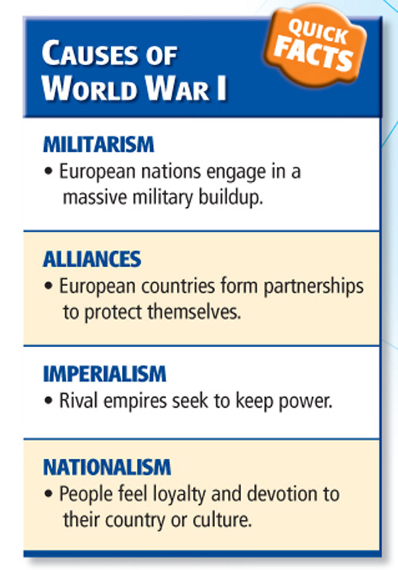
Massive military build up to defend colonies and show of strength and power.
Seeking to protection through alliances.
Quest to build Empires.
Ethnic, religious and social groups wanting to be with their own people and have their own country. Self determination.

Slide 3
Europe on the Brink of War
Some of strongest nationalist tensions in Balkans.
Balkans= Geographical region of Southeast Europe. The region takes its name from the Balkan Mountains that stretch from the east of Serbia to the Black Sea at the east of Bulgaria. The Balkans are considered to include, Albania, Bosnia and Herzegovina, Bulgaria, Croatia, Greece, Kosovo, the Republic of Macedonia, Montenegro, Serbia, Slovenia, and the European part of Turkey.
Serbian leaders wanted to expand borders, unite people in “greater Serbia”
Austria-Hungary, powerful empire to north, opposed expansion of Serbia. Feared unification might encourage other ethnic groups to rebel.

Slide 4
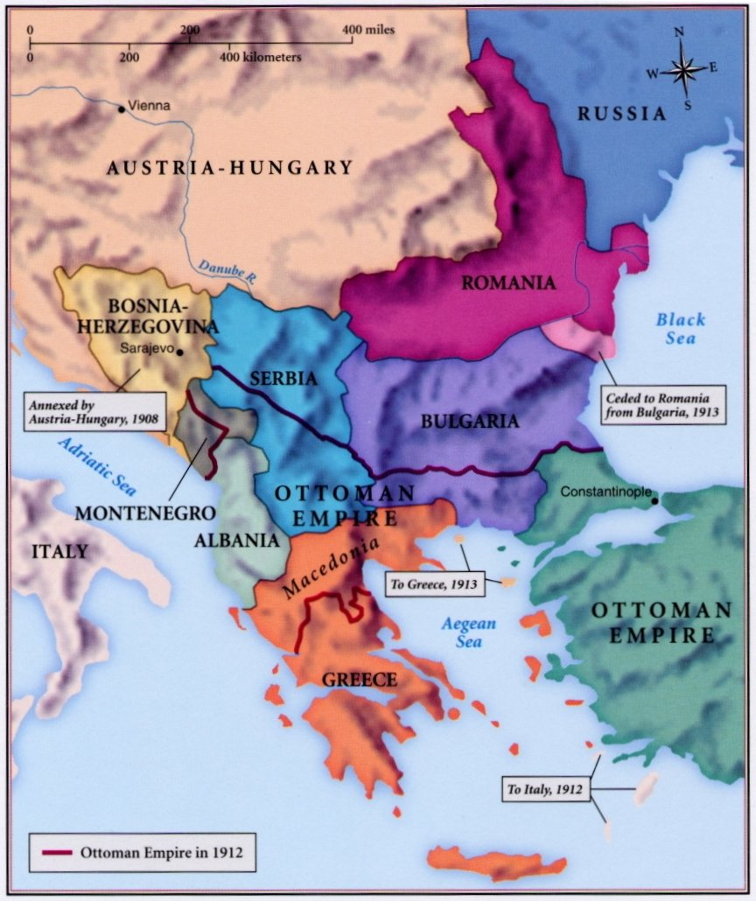
BALKAN REGION OF SOUTHEASTERN EUROPE

Slide 5
War Breaks Out
In the midst of the tensions with Serbia, archduke Ferdinand of Austria-Hungary decided to visit the Bosnian city of Sarajevo.
The Impact
Fighting Begins
Serbian Gavrilo Princip assassinated archduke, wife
Austria-Hungary declared war on Serbia
Russia prepared to support Serbia
Austria-Hungary ally Germany saw Russia as threat
Germany declared war on Russia, ally France
Germany faced war on two fronts: Russia to east, France to west.
Decided to strike France quickly then move to Russia
Began with quick strike into neutral Belgium
Attack on neutral country led Great Britain to declare war on Germany

Slide 6
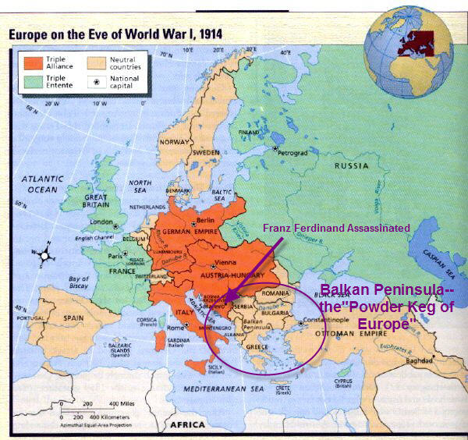

Slide 7
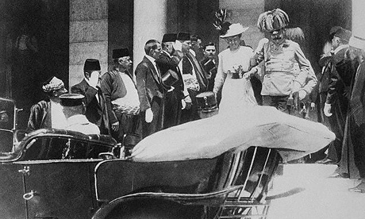

Slide 8
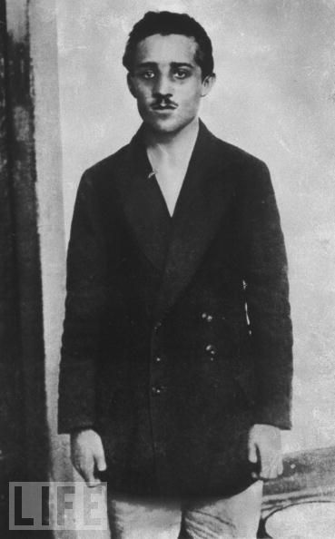
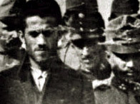
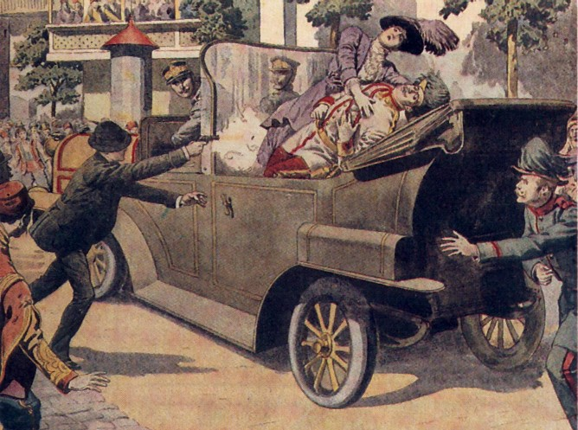

Slide 9
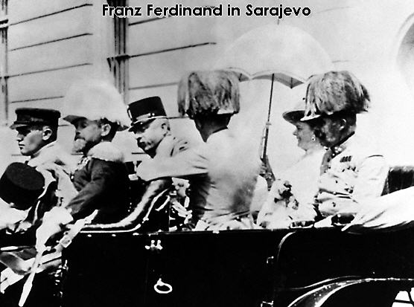

Slide 10
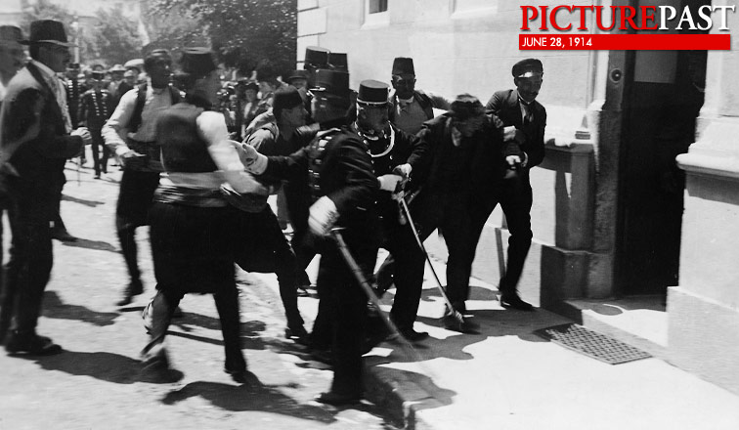

Slide 11
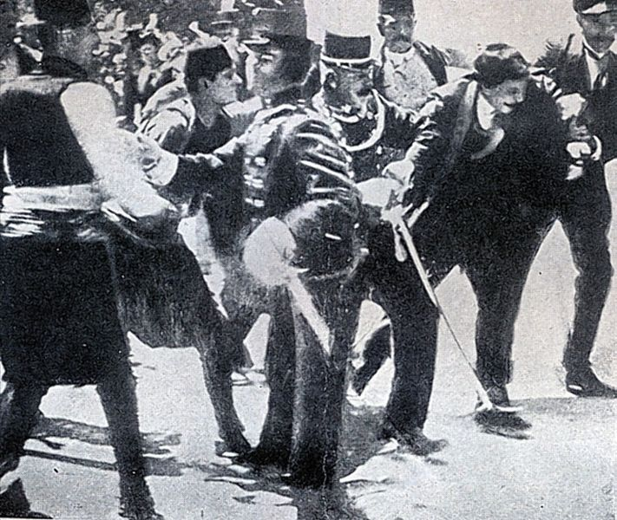

Slide 12
FIGHTING BEGINS
Austria-Hungary decided to use the murder as an excuse to punish Serbia. They make a series of humiliating demands on Serbia:
Serbia was also to suppress all anti-Austrian propaganda.
Root out and eliminate terrorist organizations within its borders—one such organization, the Black Hand, was believed to have aided and abetted the archduke’s killer, Gavrilo Princip, and his allies, providing weapons and safe passage from Belgrade to Sarajevo.
Must answer demands within 48 hours. Didn’t happen.
Austrian/Hungarian troops march into the Balkans.
German troops use the Schlieffen plan with a quick strike of force into neutral Belgium to attack France and quickly take them over.
The Schlieffen Plan was created by General Count Alfred von Schlieffen in December 1905.

Slide 13
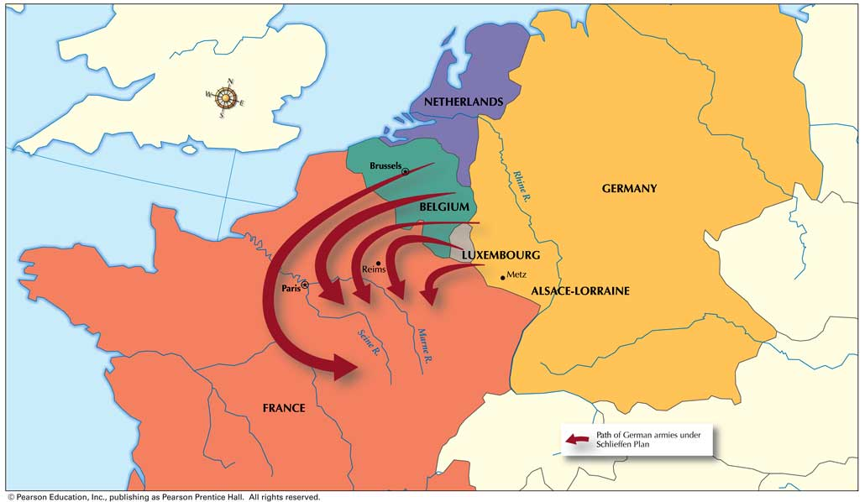
The Schlieffen Plan
Germany’s plan to attack and conquer France first.
6 of 7

Slide 14
War Breaks Out
Main players in World War I in place
Central Powers
Germany
Austria-Hungary
Allied Powers
Great Britain
France
Russia
Serbia

Slide 16
World War I and the Russian Revolution: Section 1
Note Taking Transparency 169
4 of 7

Slide 17
World War I and the Russian Revolution: Section 1
Chart: Reasons for Entering the War, July-August 1914
5 of 7

Slide 18
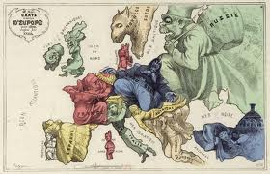

Slide 19
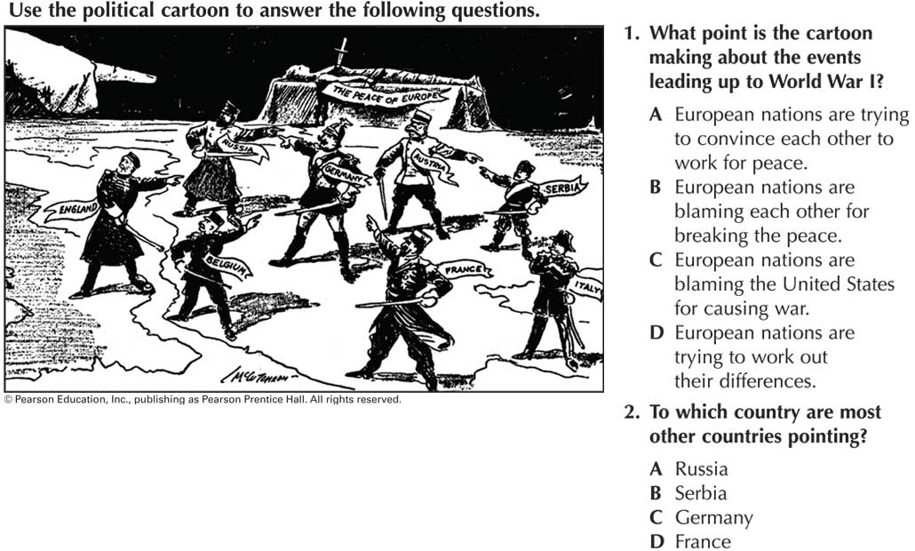
7 of 7

Slide 20
MUST ANSWER THESE QUESTIONS AND TURN IT IN FOR A GRADE
Why was Europe on the brink of war in 1914?
Why did war break out?
What is the name of the country where the assassination took place?
What is the Schlieffen Plan?
What were the results of the fighting in 1914?

Slide 21
A New Kind of War
In 1914 Europe was drawn into war. With the introduction of new types of warfare and new technologies, WW1 resulted in destruction on a scale man had never seen or imagined.
Key terms to know:
Trench Warfare
Total War
Propaganda
Battle of Verdun
Gallipoli Campaign
Genocide

Slide 22
Fighting in 1914
Germany’s Schlieffen plan
Germany wanted to quickly defeat France, move east to fight Russia
Great Britain’s declaration of war on Germany doomed its plan
The Great War became bloody stalemate
Early battles
Battle of the Frontiers pitted German troops against both French and British
Both sides suffered heavy losses
Germany victorious
Russia enters fighting
Russia attacked German territory from the east
Russians defeated in Battle of Tannenberg lost 92,000 men to surrender.
Germany distracted from France, Allies turned on German invaders

Slide 23
The World War I Battlefield
Trench warfare begins
Allied troops drove Germans back, Battle of the Marne, September 1914
Retreating Germans dug series of trenches along Aisne River
Waited in trenches for Allied attack
Trenches elaborately constructed, cleverly concealed
Schlieffen plan fails.
Allies dug trenches of their own
Major battles for months with little change in positions
Deadlocked region became known as Western Front

Slide 24
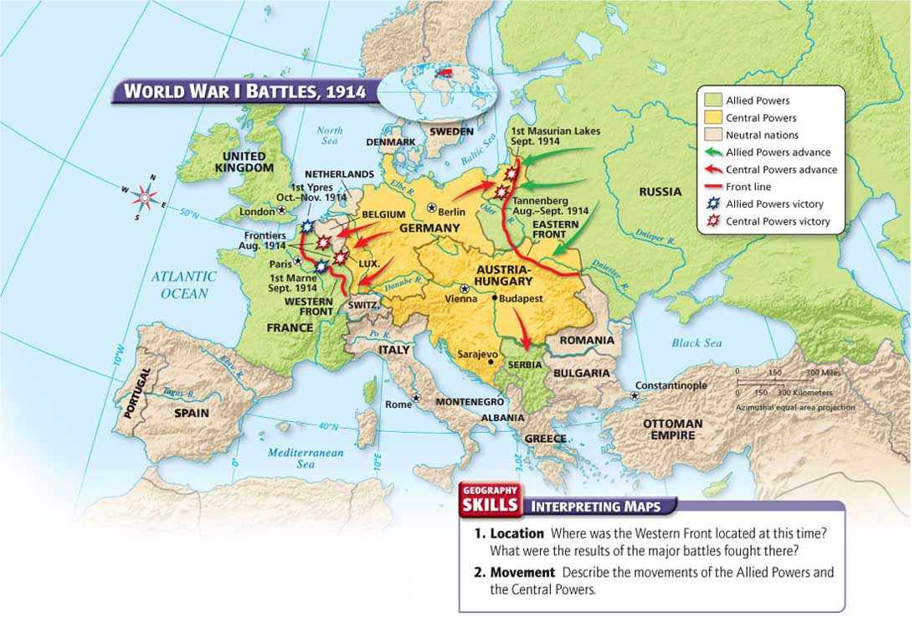
December 25th 1914 Christmas Truce.
Both sides it was said to have played a soccer game.
Sing Christmas carols.

Slide 25
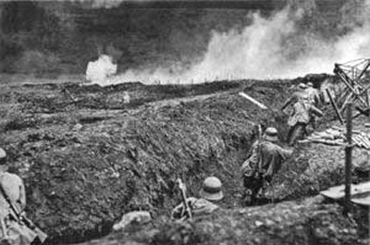

Slide 26
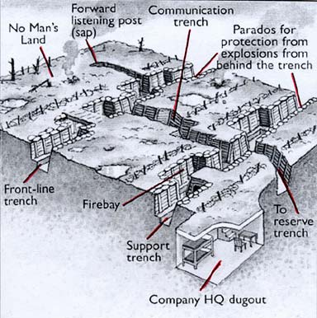

Slide 27
The World War I Battlefield
New weapons Leads to WW1 being more destructive then earlier wars.
Poison gas, other new weapons response to massive deadlock
Two systems of trenches stretched hundreds of miles, western Europe
Millions of Allied and Central Powers soldiers in trenches of Western Front
Trench warfare
Trench warfare: Fighting from trenches> not new idea
Soldiers had long hidden behind mounds of earth
Scale of 1914 Europe trench warfare never before experienced
Life in trenches was miserable
Rainstorms produced deep puddles, mud
Lice, rats, bad sanitation constant problems
Removing dead bodies often impossible

Slide 28
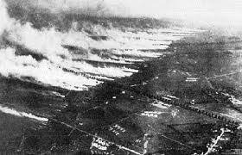

Slide 29
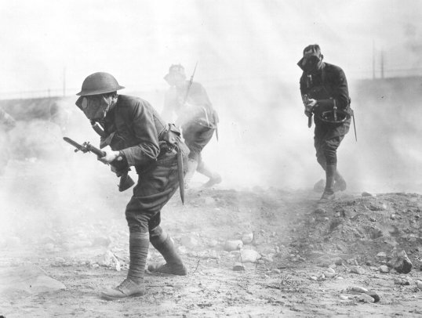

Slide 30
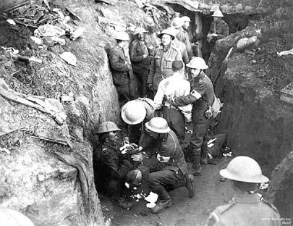

Slide 31
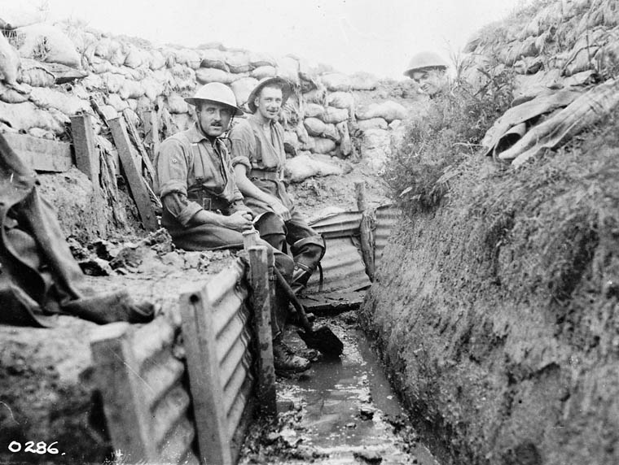

Slide 32
The World War I Battlefield
Over the top
Soldiers ordered out of trenches to attack enemy
Sprinting across area known as “no-man’s-land” a deadly game
Thousands on both sides died, cut down by enemy guns
New weapons
Neither side able to make significant advances on enemy’s trenches
Each side turned to new weapons like poison gas
Value limited, both sides developed gas masks
More effective
Other new weapons more effective than poison gas
Rapid-fire machine guns in wide use
Artillery and high-explosive shells, enormous destructive power

Slide 33
The World War I Battlefield
Tanks and Aircraft
Tanks pioneered by British
Could cross rough battlefield terrain
Reliability was a problem
Aircraft most useful
At beginning of war, mostly for observation
Soon had machine guns, bombs attached
Faster airplanes useful in attacking cities, battlefields

Slide 34
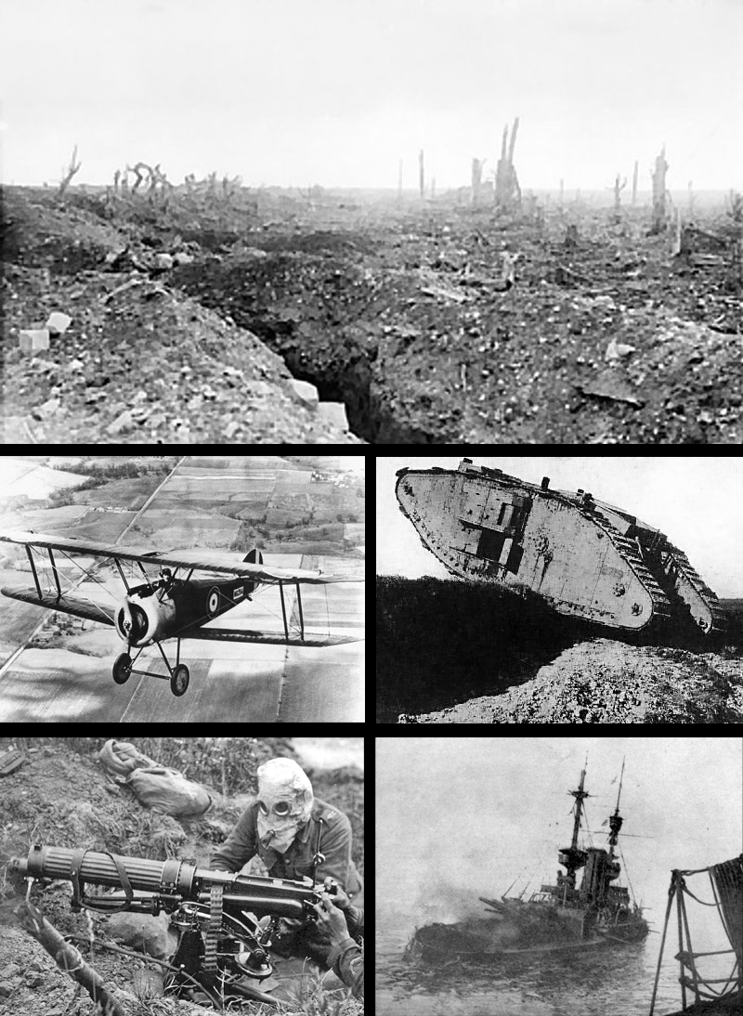

Slide 35
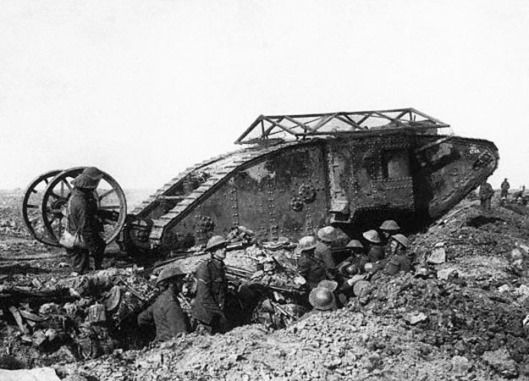

Slide 36
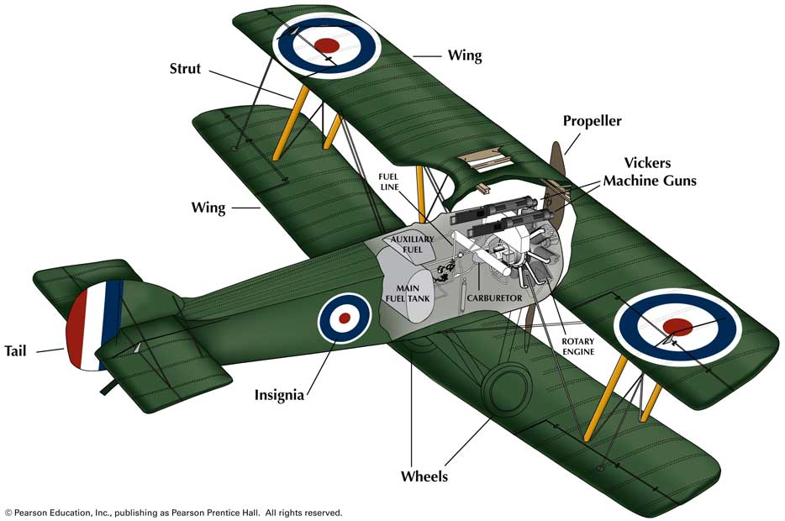
World War I and the Russian Revolution: Section 2
Color Transparency 158: The Sopwith Camel
5 of 8

Slide 37
Using society’s resources to win the war:
Government Actions
Government Control
Winning new type of war required use of all society’s resources
Total war: A war with no restrictions of weapons used, the territory or combatants involved, or the objectives pursued, especially one in which the laws of war are disregarded.
governments took stronger control of citizens’ lives by changing nations’ industries, economies to produce military equipment.
citizens conserved food, other goods
Sought to control public opinion
Censored newspaper reports about fighting to keep from discouraging public.
Not reporting the amount of people dead or the hazards of this “new” war.
Created propaganda, information to influence opinions, encourage volunteers
Posters, pamphlets, articles about enemy’s brutal actions.

Slide 38
Summarize
How did new technology affect the World War I battlefield?
Answer(s): New technologies such as poison gas and rapid-firing machine guns made the battlefield more dangerous; faster airplanes proved useful in attacking battlefield positions, factories, and cities; neither side was able to gain an advantage.

Slide 39
Women and the War
Millions of men at battle most of the work on home front done by women.
Some worked in factories, producing war supplies
Others served as nurses to wounded
Contributions of women
Transformed public views of women and what they could do.
Helped women win right to vote in some countries.

Slide 40
Battles on the Western Front
While people on the home front supported their troops, the war in Western Europe was going badly for the Allied Powers.
The Italian Front
The Battle of Verdun
Italy joined Allied Powers, May 1915
Sent forces against Austria-Hungary at border with Italy
Series of back-and-forth battles
Little progress made
Germans planned assault on French fortress, Verdun
Believed French would defend fortress at all costs
Battle of Verdun meant to kill, injure as many French soldiers as possible
400,000 French casualties in 10 months of fighting, almost as many for Germany

Slide 41
The Battle of the Somme
British launched attack in Somme River area to pull German troops away from Verdun
Main assault during 1916, but no major breakthrough
Both sides lost great number of troops; British suffered nearly 60,000 casualties on the first day of fighting
The Third Battle of Ypres (Ypres near the British Channel)
Failed French offensive caused rebellion among French soldiers, spring 1917
British began offensive near Ypres, Belgium, site of German attacks
Third Battle of Ypres a disaster for British
After 3 years of battle, front lines remained virtually unchanged

Slide 42
War around the World
Much of the early fighting took place in Europe, but the conflict quickly became a true world war as fighting spread around the globe. Over 30 nations officially took sides in the war.
Gallipoli Campaign
Spring 1915
Major Loss
Ottoman Empire joined Central Powers, late 1914
Controlled sea passage, Dardanelles
Used by Allies to ship supplies to Russia
Allies landed force on Gallipoli Peninsula
Attempted to destroy guns, forts on Dardanelles
Gave up after months of fighting, 200,000 deaths
Ottoman subjects in Arabian Peninsula rebelled later in war
British sent T.E. Lawrence to support Arabs
Arabs overthrew Ottoman rule

Slide 43
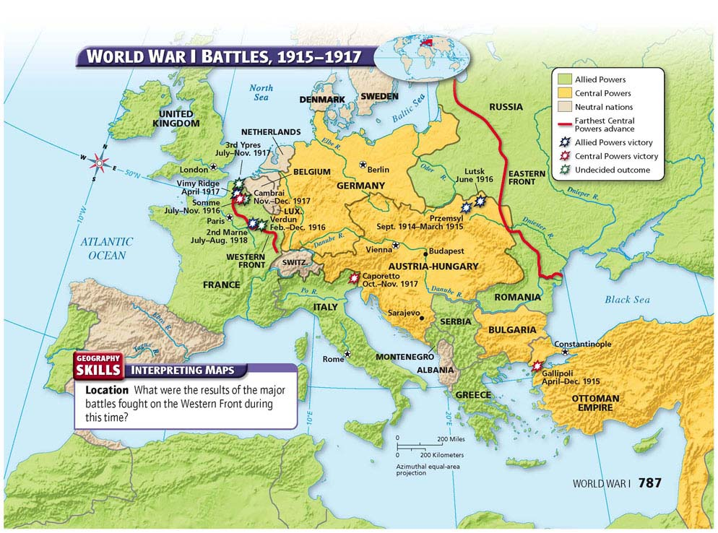

Slide 44
War around the World
Armenian Massacre
Different conflict elsewhere in Ottoman Empire during Gallipoli Campaign
Russia launched attack in Caucasus
Caucasus
Mountain region between Black and Caspian seas
Home to ethnic Christian Armenians, minority in Muslim Ottoman Empire
Use of Force
Ottoman leaders claimed Armenians aided Russians
Began forcibly removing Armenians from Caucasus, spring 1915
Violence, starvation
600,000 Armenians died in massacre
Ottoman leaders accused of genocide, destruction of racial, political or cultural group

Slide 45
War around the World
Other Fighting
War also fought in Asia and Africa
Japan declared war on Germany
Part of military agreement with Great Britain
Japanese captured German colonies in China and Pacific Islands
British, French attacked German colonies in Africa
Allied colonies scattered around world made contributions to war
Some colonists worked as laborers to keep armies supplied
Others fought, died in battles in hope of winning independence
Hopes were in vain
End of section 2 chapter 26

Slide 46
The War Ends
After several years of bloody stalemate-and the entry of the United States into the conflict-the Allied Powers finally prevailed. The peace, however, proved difficult to establish.
KEY TERMS AND PEOPLE
Woodrow Wilson
Zimmerman Note
Armistice
14 points
Treaty of Versailles

Slide 47
The United States Enters the War
German attacks on ships carrying Americans angered American people, leaders
German plan to have Mexico attack U.S. also surfaced
American Neutrality
American public generally supported Allies
U.S. remained neutral officially
President Woodrow Wilson believed U.S. should stay out of affairs of other nations
“He kept us out of war”

Slide 49
Trouble on the seas
Remaining neutral not easy with Germany attacking civilian ships
Attacks part of policy called unrestricted submarine warfare
Any ship traveling in waters around Great Britain subject to attack by German U-boats
Lusitania
Initially U-boats attacked only military, merchant ships
Passenger ship Lusitania sunk, 120 Americans among the dead
Fearing U.S. entry into war, Germany agreed to stop attacking passenger ships
Germany hoped to defeat Allied powers before U.S. entered war

Slide 50
The Zimmermann Note
Final push to war
Repeated attacks on shipping brought U.S. close to war on Germany
Discovery of Zimmermann Note final push, February 1917
Secret message from German diplomat Arthur Zimmermann to Mexico
Contents of note
Germany proposed Mexico attack the U.S. in return for U.S. land
Promised Texas, Arizona and New Mexico, all once belonging to Mexico
Hoped war with Mexico would keep U.S. out of war in Europe
Call for war
American public called for war against Germany
U.S. had kinship, financial ties to Great Britain, Allied Powers
U.S. entered war on side of Allied Powers, April 1917

Slide 51
Identify Cause and Effect
How did unrestricted submarine warfare affect U.S. entry into the war?
Answer(s): Germany broke its promise to the United States to stop attacking passenger ships.

Slide 52
The End of the Fighting
German leaders knew America entering the war would increase the strength of Allied Powers.
A New German Offensive
Assault on West
Wanted to deal decisive blow to Central Powers before U.S. had time to ready for war
Opportunity came with Russia’s withdrawal from war
Russia out by end of 1917
German troops no longer needed on Eastern front
Could launch new offensive in the west
Launched major assault, March 1918
Made progress, advanced to within 40 miles of Paris
High cost to Germany, lost 800,000 troops
By June, 1918, U.S. troops arrived in Europe
Gave Allies hope, discouraged Germans

Slide 53
German Collapse
Balance of power shifted
Allied forces stopped German assault in Second Battle of the Marne
Allies now on the offensive after stopping the assault
Allies used tanks, aircraft; gained huge amounts of territory
Germany a defeated force
Many Germans gave up without a fight
Began to doubt their own power
Great turmoil within German ranks
End of war
Allied forces broke through Hindenburg Line
German leaders sought armistice with Allies
Other Central Powers also admitted defeat, war ended

Slide 54
A Difficult Peace
Although peace had come to the battlefield, the leaders of the war’s major countries still had to work out a formal peace agreement. This task would prove difficult.
Wilson’s Vision
Allied Goals
Wilson announced his vision of world peace, Fourteen Points
Included reduction of weapons, right of people to choose own government
Proposed organization of world nations, protect from aggression
Leaders of four major Allies all had different ideas of peace treaty
French wanted to punish Germany, reparations for cost of war
British wanted to punish Germany, but not weaken it
Italy’s leader hoped to gain territory for his nation, but was disappointed to find himself mostly ignored by other leaders during peace talks.

Slide 55
A difficult peace
In early 1918 while fighting was still going on Woodrow Wilson created a plan for peace called the 14 points plan. The points included the reduction of weapons and the right of all people to chose their own governments.
He also proposed forming an organization where all the world’s nations would join in order to protect one another from war.
The world leader’s did not share the same views, but did share some of the same principles:
Resulting in= The Treaty of Versailles:
Named after the French Palace of Versailles where the treaty signing took place.
Germany forced to pay enormous amount of money to war victims.
Germany was forced to take full responsibility for the war.
Other parts of the treaty meant to weaken Germany, such as limit their size of military.
Germany had to return conquered lands to France and Russia.
Other German lands were taken to form Poland, and colonies given up to other nations.
It established the League of Nations. Treaty signed on June 28th 1919.
Germans were excluded from the League of Nations and were furious about the agreement.

Slide 56
Aftermath
League of Nations
Organization of world governments proposed by Wilson
Established by Treaty of Versailles
Main goals
Encourage cooperation, keep peace between nations
Germany excluded
U.S. did not ratify treaty, not member, weakened League
Other treaties
Separate agreements with all defeated Central Powers
Made important changes to Europe
Changes in Europe
Austria-Hungary, Ottoman Empire lands broken apart
Independent nations created: Austria, Hungary, Yugoslavia, Czechoslovakia, Turkey

Slide 57
The Middle East
Changes in Middle East
Zionist movement
Former Ottoman lands turned into mandates, territories to be ruled by European powers
Syria, Lebanon became French mandates
Palestine, Iraq became British mandates
European nations supposed to control mandates only until they were able to govern selves
Movement to create a Jewish state in the Middle East
Balfour Declaration favored establishing Jewish state in Palestine
Britain created Transjordan from Palestine Mandate
Mandates eventually became colonies

Slide 58
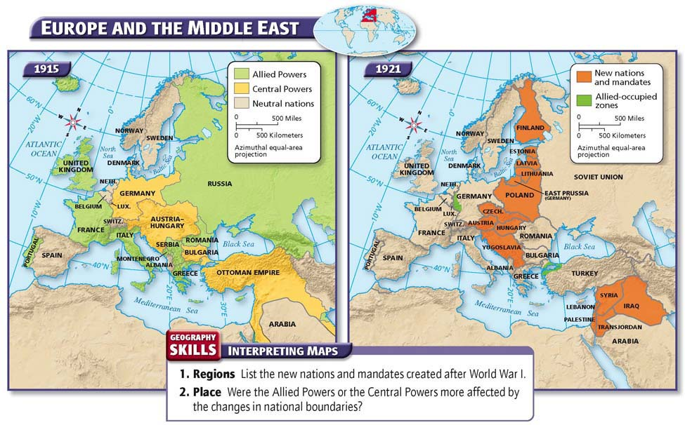

Slide 59
The Costs of the War
Human Costs
Nearly 9 million soldiers killed in battle
Millions wounded, taken prisoner
Almost an entire generation of young German, Russian, French men died, were wounded in war
Deadly outbreak of influenza spread by returning soldiers killed some 50 million worldwide, spring 1918
Economic Costs
Political Change
War destroyed national economies
Farmland, cities devastated
Economic chaos in much of Europe
Cost Europe role as dominant economic region of world
U.S., Japan, others prospered during war
World War I caused widespread political unrest
Communist revolution in Russia
Monarchies in Austria-Hungary, Ottoman Empire overthrown
Political, social turmoil would shape world in years to come

Slide 60
The Costs of the War
Unrest in Colonies
Many colonists who fought in war heard noble words about importance of freedom, democracy
After fighting for colonial rulers, expected rights for themselves
Wartime sacrifices did not win new freedoms
European powers split up lands controlled by Germans, Austro-Hungarians, Ottomans and redistributed them to other colonial powers

Slide 61
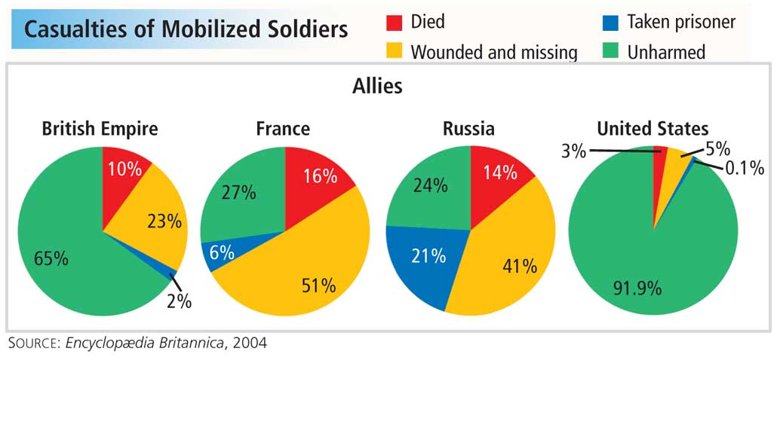
World War I and the Russian Revolution: Section 4
Pie Charts: Allied Casualties
5 of 9

Slide 62
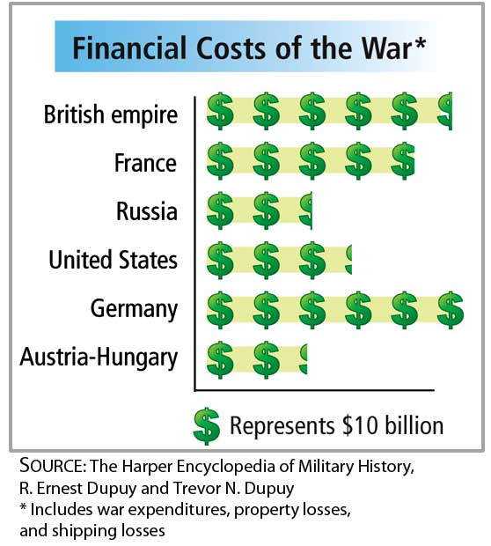
World War I and the Russian Revolution: Section 4
Graph: Financial Costs of the War
6 of 9

Slide 63
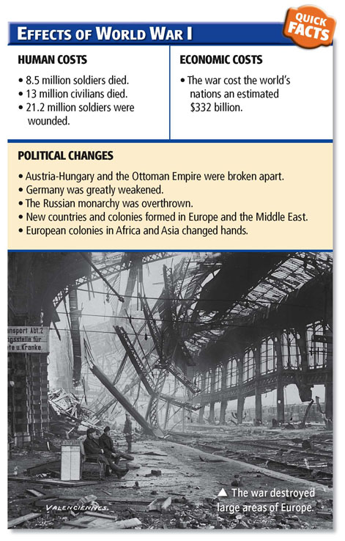

Slide 64
World War I and the Russian Revolution: Section 4
Note Taking Transparency 172B
8 of 9

Slide 65
Summarize
What were the costs of the war?
Answer(s): Millions of people died or were wounded. Some nations' economies were devastated while others prospered. Some people enjoyed the benefits of freedom and democracy after the war, but others remained under the control of colonial rulers.

