Slide 1
Vietnam war
In 1940 Japan invaded Vietnam, becoming one of a series of foreign nations to rule the Asian country. The Chinese had controlled the region for hundreds of years. Then, from the late 1800s until World War II, the French ruled Vietnam, Laos, and Cambodia—a region then known as French Indochina.

Slide 2
Ho Chi Minh
By the early 1900s, nationalism had become a powerful force in Vietnam.
Several political parties pushed for independence or for reform of French colonial rule. Among the leaders of the nationalist movement was Ho Chi Minh. After years in Europe, China, and the Soviet Union, he returned to Southeast Asia. There, he helped found the Indochinese Communist Party in 1930 and worked for independence.
Ho Chi Minh, In 1941 returned to Vietnam. By then, Japan had seized control of the country. Ho Chi Minh organized a nationalist group called the Vietminh, which united Communists and non-Communists in the effort to expel the Japanese.

Slide 3
France losing Indochina
China’s fall to communism and the outbreak of the Korean War helped convince President Truman to aid France.
President Eisenhower continued Truman’s policy and defended his decision with what became known as the domino theory—the idea that if Vietnam fell to communism, the rest of Southeast Asia would follow, like a line of dominoes falling over.

Slide 4
Vietnam War 1954-1975
Due to the policy and principle of the Domino theory President Eisenhower kept sending troops even after Truman left office.
Through the years, US troops trained South Vietnamese troops to fight the Communists.
After the Gulf of Tonkin Resolution, under LBJ, escalated US troop levels and U.S commitment to War in Vietnam.

Slide 5
Geneva Accords
Divided into North and South at the 17th parallel.
Ho Chi Minh and the Vietminh controlled North Vietnam.
Pro-Western regime led by the fiercely anti-Communist Ngo Dinh Diem (ehn• GOH DIHN deh•EHM) held the South.
Our first presence there was as military advisors to the South Vietnamese army.
We wanted to contain communism while protecting our interests in South East Asia.

Slide 6
Fight for Vietnam
After Ngo Dinh Diem refused to hold national elections, Ho Chi Minh and the Communists began an armed struggle to reunify the nation.
They organized a new guerrilla army of South Vietnamese Communists, which became known as the Vietcong.
Eisenhower sent hundreds of military advisers to train South Vietnam’s army, but the Vietcong continued to grow more powerful because many Vietnamese opposed Diem’s government. By 1961, the Vietcong had established control over much of the countryside.

Slide 7
South Vietnam losing?
In August 1963, U.S. ambassador Henry Cabot Lodge arrived in Vietnam. He learned that several Vietnamese generals were plotting to overthrow the unpopular Diem. When Lodge expressed U.S. sympathy for their cause, the generals launched a military coup, seizing power on November 1, 1963. They executed Diem soon after. Despite his unpopularity, Diem had been a respected nationalist. After his death, South Vietnam’s government weakened.

Slide 8
Gulf of Tonkin Resolution
On August 2, 1964, Johnson announced that North Vietnamese torpedo boats had fired on two U.S. destroyers in the Gulf of Tonkin. Two days later, he reported another attack. Insisting that these were unprovoked, he ordered American aircraft to attack North Vietnamese ships and naval facilities.
President Johnson asked Congress for the authority to defend American forces and allies in Southeast Asia.
Congress on August 7, 1964, passed the Gulf of Tonkin Resolution.
This authorized the president to “take all necessary measures to repel any armed attack against the forces of the United States and to prevent further aggression.” Soon after, the Vietcong began to attack bases where American advisers were stationed in South Vietnam. After one particularly damaging attack, Johnson sent American aircraft to bomb North Vietnam.

Slide 9
Vietcong
Lacking the firepower of the American forces, the Vietcong used ambushes, booby traps, and other guerrilla tactics. These techniques could be greatly destructive.
The Vietcong also frustrated American troops by blending in with the general population and then quickly vanishing.

Slide 10
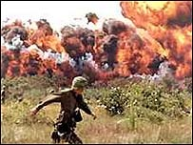
“Search and Destroy”
To counter Guerilla warfare of the Vietcong , American troops tried to find enemy troops, bomb their positions, destroy their supply lines, and force them out into the open for combat.
American planes dropped napalm, a jellied gasoline that explodes on contact. They also used Agent Orange, a chemical that strips leaves from trees and shrubs, turning farmland and forest into wasteland.

Slide 11
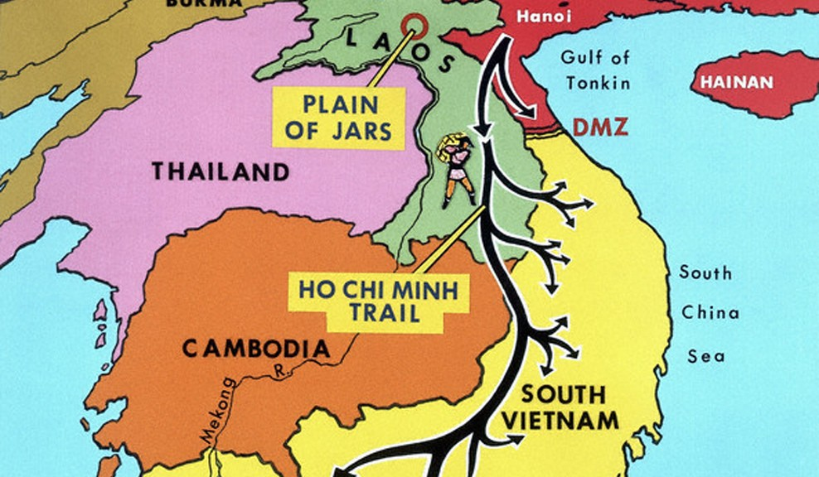
The Ho Chi Minh Trail
North Vietnam provided arms, advisers, and leadership to the Vietcong.
As Vietcong casualties mounted, North Vietnam began sending North Vietnamese Army units to fight.
North Vietnam sent arms and supplies south by way of a network of jungle paths known as the Ho Chi Minh Trail. The trail wound through Cambodia and Laos, bypassing the border between North Vietnam and South Vietnam.

Slide 12
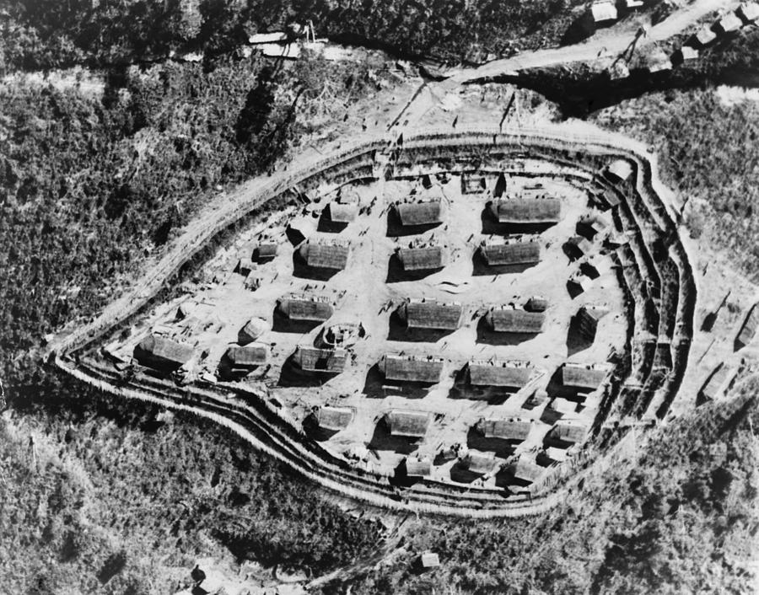
Strategic Hamlet
Special fortified villages created by the South Vietnamese to protect against the VC.

Slide 14
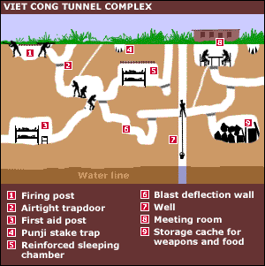

Slide 15
Key Battles of the War
1954
Battle of Dien Bien Phu
1968
Tet Offensive
1975
Fall of Saigon
1964
Gulf of Tonkin
1973
Paris Peace Agreement
Timeline of Key Events

Slide 16
America’s view of the war at Home
By 1965, about 66 percent of Americans approved of U.S. policy in Vietnam.
Media accounts seemed to contradict government reports. For example, the American commander in South Vietnam, General William Westmoreland, reported that the “enemy’s hopes are bankrupt” and “the end begins to come into view.” Yet millions of people saw images of American casualties on television in their living rooms each day as
Vietnam became the first “television war.”
For many people, a credibility gap had developed—they had a hard time believing what the Johnson administration said about the war.

Slide 17
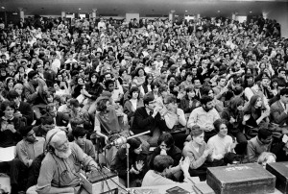
Teach-Ins
March 1965, a group of faculty members and students at the University of Michigan joined together in a teach-in.
Teach ins discussed the issues surrounding the war and reaffirmed their reasons for opposing it. In May 1965, 122 colleges held a “National Teach-In” by radio for more than 100,000 antiwar demonstrators.

Slide 18
Anger at the Draft
Thousands of demonstrators held protests against the war. Students for a Democratic Society (SDS) organized a march on Washington, D.C., that drew more than 20,000 people.
Many protesters focused on what they saw as an unfair draft system. Until 1969, college students could often defer military service until after graduation.
Young people from working-class families unable to afford college were more likely to be drafted. Draftees were most likely to be assigned to combat units, and they commonly made up more than half of casualties. Most who served in Vietnam, however, enlisted voluntarily.
Nevertheless, a disproportionate number of working-class and minority youths went to war.

Slide 19
Anger at the Draft
As the war escalated, an increased draft call put many college students at risk of being drafted.
An estimated 500,000 draftees refused to go. Some burned their draft cards, did not show up for induction, or fled the country.
From 1965 to 1968, officials prosecuted over 3,000 Americans who refused to serve.
In 1969 a lottery system was instituted, so only those with low numbers were subject to the draft.
Many draftees argued that if they were old enough to fight, they were old enough to vote. In 1971 the Twenty-sixth Amendment to the Constitution was ratified, giving all citizens age 18 and older the right to vote in all state and federal elections.

Slide 20
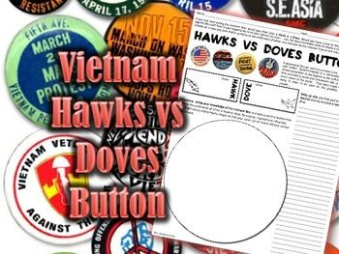
Hawks and Doves
In time, the nation seemed to be divided into two camps.
Doves wanted the United States to leave Vietnam.
Hawks, wanted the nation to stay and fight.
Some saw communism as a threat and challenged the patriotism of the doves. As the two groups debated, the war appeared to take a dramatic turn for the worse.

Slide 21
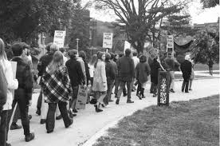
1968: The Pivotal Year
The most turbulent year of the chaotic 1960s was 1968. The year saw a shocking political announcement, two traumatic assassinations, and a political convention held amid strident antiwar demonstrations. First, however, the United States endured a surprise attack in Vietnam.
At one point, over 500,000 U.S. troops were fighting in support of South Vietnam.

Slide 22
Vietnam, 1968
On January 30, 1968, during Tet, the Vietnamese New Year, the Vietcong and North Vietnamese launched a massive surprise attack.
In what was called the Tet Offensive, guerrilla fighters attacked most American airbases in South Vietnam and most of the South’s major cities.
Vietcong even blasted their way into the American embassy in Saigon.

Slide 23
Johnson Leaves the Race in 1968
Both Johnson and the war had become increasingly unpopular. With the presidential election of 1968 on the horizon, some Democratic politicians made surprising moves.
In November 1967, Eugene McCarthy a liberal senator from Minnesota declared that he would challenge Johnson for the Democratic presidential nomination.
At first, his candidacy was mostly dismissed, but he attracted support from those who opposed the war.
In March 1968, McCarthy made a strong showing in the New Hampshire primary, winning more than 40 percent of the vote.
Realizing that Johnson was vulnerable, Senator Robert Kennedy, who also opposed the war, quickly entered the race for the Democratic nomination.

Slide 24
Vietnam Divides the Nation
The violence that seemed to plague the country in 1968 culminated with a chaotic and well-publicized clash between antiwar protesters and police at the Democratic National Convention in Chicago.
Thousands of young activists surrounded the convention center to protest the war. Despite these protests, the delegates selected Vice President Hubert Humphrey as the Democratic nominee. Meanwhile, in a park not far from the convention hall, protesters and police began fighting. Demonstrators taunted police with the chant “The whole world is watching!” as the officers tried to force them to disperse. Violence between protesters and police aired on national television.
https://www.youtube.com/watch?v=EYp1JgwotXU

Slide 25
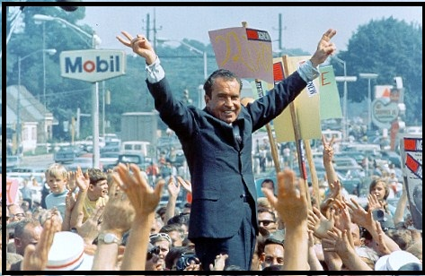
Nixon Wins the Presidency
Republicans selected former vice president and 1960 presidential hopeful Richard Nixon as their candidate.
He won the election by promising to unify the nation and restore law and order.

Slide 26
Ending the War
Nixon appointed Henry Kissinger as special assistant for national security affairs.
Kissinger embarked upon a policy called linkage, or improving relations with the Soviet Union and China, to try to persuade them to reduce their aid to North Vietnam.
In August 1969, Kissinger also entered into secret negotiations with North Vietnam’s representative, Le Duc Tho.
Nixon began Vietnamization. This process involved the gradual withdrawal of U.S. troops while the South Vietnamese assumed more of the fighting.
He announced the withdrawal of 25,000 soldiers on June 8, 1969. At the same time, however, Nixon increased air strikes against North Vietnam and began secretly bombing Vietcong sanctuaries in neighboring Cambodia.

Slide 27
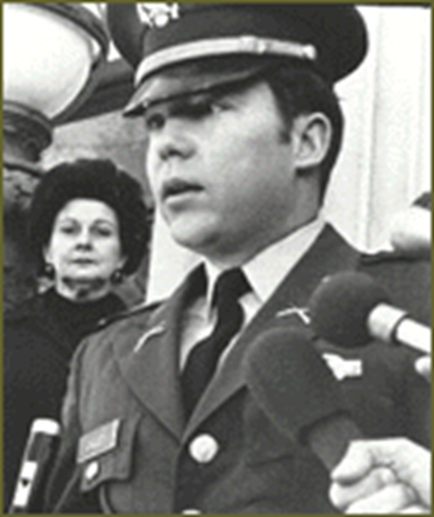
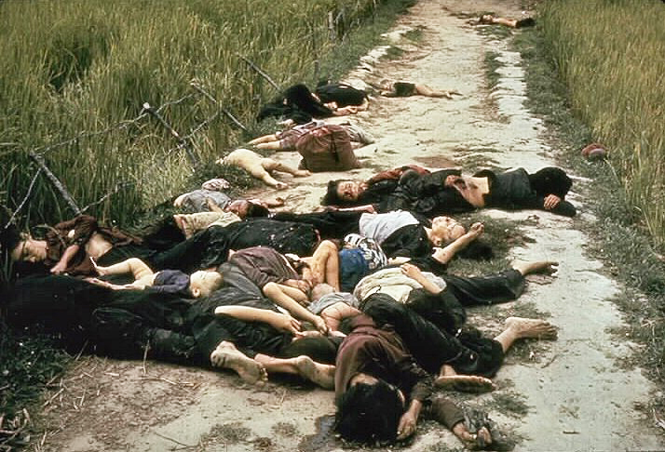
My Lai Incident
In late 1969, Americans learned that in the spring of 1968 an American platoon under the command of Lieutenant William Calley had massacred unarmed South Vietnamese civilians in the hamlet of My Lai.
Most of the victims were old men, women, and children. Calley eventually went to prison for his role in the killings.

Slide 28
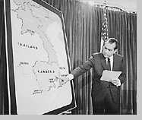
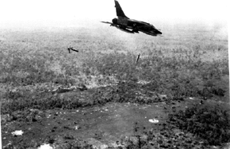
The Bombing of Cambodia
Cause: The Vietcong moved soldiers and supplies through Cambodia and Laos over the Ho Chi Minh Trail.
Result: On March 18, 1969, American B-52s began carpet-bombing eastern Cambodia and Laos and dropped 540,000 tons of bombs , killing anywhere from 150,000 to 500,000 civilians. The bombing was kept secret from the American people.

Slide 29
Ending of the War
April 1970, Nixon announced that American troops had invaded Cambodia to destroy Vietcong bases there. Many believed this invasion expanded the war, which set off many protests.
On May 4, Ohio National Guard soldiers armed with tear gas and rifles fired on demonstrators at Kent State University, killing four students. Days later, police killed two student demonstrators at Jackson State College in Mississippi.
An angry Congress began to work to end the president’s control of the war. In December 1970, it repealed the Gulf of Tonkin Resolution, which had given the president nearly complete power in directing the conflict.

Slide 31
Trying to End the War
December 1972, to force North Vietnam to resume negotiations, the Nixon administration began the most destructive air raids of the war.
In what became known as the “Christmas bombings,” American B-52s dropped thousands of tons of bombs on North Vietnamese targets for 11 straight days.
On January 27, 1973 an agreement signed “ending the war and restoring the peace in Vietnam.” The United States promised to withdraw its troops, and both sides agreed to exchange prisoners of war.

Slide 32
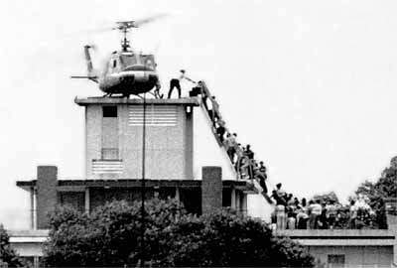
Peace with Honor
Cause: By March 1973, the last U.S. forces left Vietnam.
Result: The North Vietnamese overran South Vietnam two years later.
The last Americans leave the American Embassy in South Vietnam

Slide 33
End of the War
Peace did not last. In January 1975, Cambodia fell under the control of the Communist group the Khmer Rouge.
In March 1975, the North Vietnamese army invaded South Vietnam. Nixon had resigned in August 1974 following Watergate, a scandal that broke as the war was winding down.
When the new president, Gerald Ford, asked for funds to aid the South Vietnamese, Congress refused.
On April 30 1975, the North Vietnamese captured Saigon, South Vietnam’s capital. They then renamed the city Ho Chi Minh City.
Laos, another country in the region, was also greatly affected by the Vietnam War. Though Laos was run by a neutral coalition government during most of the war, the constant effects of bombings on the parts of the Ho Chi Minh Trail in Laos destabilized that neutrality. Communists took over in Laos after the fall of Saigon. Thus, the domino effect played out as predicted.

Slide 34
Very end of the war
he estimated $173 billion in direct costs. Approximately 58,000 young Americans died, and some 300,000 were injured. An estimated 1 million North Vietnamese and South Vietnamese soldiers died, as did millions more civilians. Back home, some soldiers had trouble readjusting.

