Slide 1
An Introduction to Demand
Demand depends on two variables: the price of a product and the quantity available at a given point in time.
In general, when the price of a product goes down, people are willing to buy, or demand, more of it. When the price goes up, they are willing to buy less.
A demand curve shows the quantity of a product demanded at each price that might prevail in the market.
Notes:
1

Slide 2
The Law of Demand
The Law of Demand states that the quantity demanded of a product varies inversely with its price.
The Law of Demand is called a “law” because it has proven true after repeated studies and tests, and it is consistent with common sense and observation.
A market demand curve shows the quantities of a product demanded by everyone who is interested in purchasing it at all possible prices.
Notes:
2

Slide 3
A Change in the Quantity Demanded
The only event that can cause a change in quantity demanded is a change in price.
A change in the quantity demanded due to a change in price is represented on a demand curve as movement along the curve.
The income effect is a change in quantity demanded because of a change in price that makes consumers feel richer or poorer.
A shift in relative prices may cause a substitution effect, in which consumers substitute an alternative less expensive product for one that has become more expensive.
Notes:
3

Slide 4
Demand and Marginal Utility
Marginal utility is the extra satisfaction or additional usefulness obtained by acquiring multiple units of a product.
As we use more and more of a product, the extra satisfaction we get from using additional quantities begins to decline; this is known as diminishing marginal utility.
Because of diminishing marginal utility, people are not usually willing to pay as much for the second, third, or fourth unit as they did for the first unit.
Notes:
4

Slide 5
A Shift in Demand
When a shift in demand occurs, the entire demand curve shifts to the left or right. This occurs when:
A change in total consumer income affects how much of a product consumers buy at all possible prices.
Consumer tastes change.
An increase in the price of a product causes an increase in demand for substitute products and a decrease in demand for the product’s complements.
Changes in Consumer expectations.
A change in the total number of consumers
Notes:
5

Slide 6
A Shift in Demand vs. A Change in Quantity Demanded
Shift in Demand | Change in Quantity Demanded
Change total consumer income | Price Change
change in taste
substitute and compliment products
Change in expectations
Change in total number of consumers
Notes:
6

Slide 7
Three Cases of Demand Elasticity
Demand elasticity is the extent to which a change in price causes a change in the quantity demanded.
Demand is elastic when a change in price causes a relatively larger change in quantity demanded.
Demand is inelastic when a change in price causes a relatively smaller change in quantity demanded.
Demand is unit elastic when a change in price causes a proportional change in quantity demanded.
To measure the elasticity of demand, compare the percentage change in quantity demanded to the percentage change in price.
Notes:
7

Slide 8
Determinants of Demand Elasticity
Demand is usually inelastic if consumers cannot postpone the purchase of a product.
When acceptable substitutes are available for a product, demand becomes more elastic.
Demand for purchases that require a large portion of income is generally more elastic than the demand for purchases that require a smaller amount of income.
Notes:
8

Slide 9
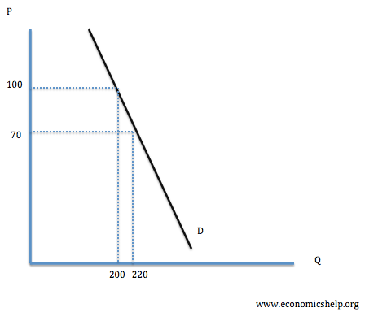
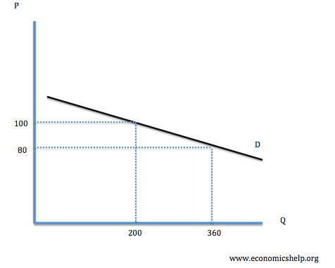
Examples of Inelastic Goods
Gas/Oil - Need it to power most cars, a very large increase in price would be needed to actually reduce our quantity demanded
Salt - Few alternatives and a small amount is purchased and lasts quite a while. We probably wouldn’t even notice a price increase.
Goods produced by monopoly - No/few alternatives, if we need it, we don’t have a choice. If we only want it, it will be more elastic.
Tap Water - No alternatives
Cigarettes - Addiction factor
Inelastic Goods
Elastic Goods
Notes:
9

Slide 10
An Introduction to Supply
Supply is the amount of a product offered for sale at all possible prices in a market.
The Law of Supply states that more product will be offered for sale at higher prices than at lower prices.
Normal individual supply curves have a positive slope that goes up from left to right; if price goes up, quantity supplied goes up as well.
The market supply curve is similar to the individual supply curve, except that it shows the quantities offered by all producers in a given market.
Change in quantity supplied refers to a change in the quantity of a product offered for sale in direct response to a change in price.
Notes:
10

Slide 11
Shift in Supply
Whereas a change in quantity supplied occurs only when prices change, a shift in supply occurs when quantities change even though price remains constant.
Factors that can cause a shift in supply include cost of resources, productivity, technology, taxes, subsidies, government regulations, number of sellers, and expectations.
Notes:
11

Slide 12
A Shift in Supply vs. A Change in Quantity Supplied
Shift in Supply | Change in Quantity Supplied
Cost of Resources | Price Change
Increase or Decrease in Productivity
Technology Changes
Taxes/Subsidies/Regulation
Number of Sellers
Expectations
Notes:
12

Slide 13
How Prices Adjust
Buyers who want to find bargains and sellers who hope for large profits both play a part in determining price.
Because transactions in a market economy are voluntary, the price compromise that settles the differences between buyers and sellers must benefit both parties.
When used together, supply and demand curves intersect at the equilibrium price, where the quantity of products supplied equals the quantity demanded.
A surplus occurs when the price for a product is too high.
A shortage occurs when the price for a product is too low.
Notes:
13

Slide 14
Why Prices Shift
Shifts in supply can cause large price variations.
Factors that affect individual demand also affect the market demand for goods, which affects the prices of those goods.
In most cases, price is affected by concurrent changes in supply and demand.
The price system is more efficient when markets are competitive.
Competitive markets allow prices to adjust naturally in response to surpluses and shortages.
Competitive markets allocate resources efficiently.
Notes:
14

Slide 15
Controlling Prices
In the modified free enterprise economy of the United States, the government sometimes interferes in the market to achieve a socially desirable goal.
A price ceiling is a maximum legal price that can be charged for a product, and because it is set below the product’s equilibrium point, the result is a shortage.
A price floor is the lowest legal price that can be charged for a product, and because it is set above the product’s equilibrium point, the result is a surplus.
Notes:
15

Slide 16
Examples of Fixed Price Policies
A price floor is being used in the sugar industry to stabilize sugar (farm) prices and to help domestic producers compete with foreign producers.
Some cities use price ceilings to control rents and make housing affordable for middle and low-income consumers.
Government legislation to achieve any of the seven broad economic and social goals most Americans share usually conflicts with at least one of the other goals.
After price supports such as price ceilings and floors are put in place, they often have enough political support to keep them there, even when they are no longer needed.
Notes:
16

Slide 17
When Markets Talk
Markets send signals that collectively represent the actions of buyers and sellers.
When prices move up or down significantly in reaction to a related event, markets are said to “talk.”
Examples of events that may cause markets to talk include a rise in gold prices, a fall in stock prices, and a rise in oil prices.
Notes:
17

