Slide 1
Why is this image a good one to symbolize the chapter Supply?
Notes:
(The quantity of a product to supply or to offer for sale is something all businesses must decide. It is the basic element of business in a market economy.) In a class discussion, lead students to understand that in a market or capitalist economic system, private companies, not the state, decide all supply issues.

Slide 2
Supply
The analysis of the supply of produced goods has two parts:
An analysis of the supply of the factors of production to households and firms.
An analysis of why firms transform those factors of production into usable goods and services.

Slide 3
Law of Supply
Law of Supply states that more product will be offered for sale at higher prices than at lower prices.
Supply is the amount of a product offered for sale at all possible prices in a market
The height of the supply curve at any quantity shows the minimum price necessary to induce producers to supply that next unit to market.
The height of the supply curve at any quantity also shows the opportunity cost of producing the next unit of the good.

Slide 4
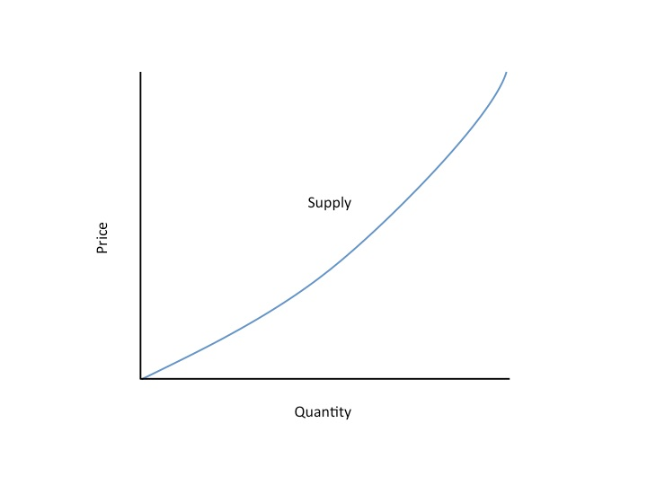
Supply Curve

Slide 5
The Law of Supply
The law of supply is accounted for by two factors:
When prices rise, firms substitute production of one good for another.
Assuming firms’ costs are constant, a higher price means higher profits.

Slide 6
The Law of Supply
The law of supply states that there is a positive relationship between price and quantity of a good supplied.
This means that supply curves typically have a positive slope.

Slide 7
Supply Schedule
A supply schedule shows how much of a good or service would be supplied at different prices.
Supply Schedule for Coffee Beans
Price of coffee beans (per pound) | Quantity of coffee beans supplied (billions of pounds)
$2.00 | 11.6
1.75 | 11.5
1.50 | 11.2
1.25 | 10.7
1.00 | 10.0
0.75 | 9.1
0.50 | 8.0
Notes:
Figure Caption:
Figure 3-6: The Supply Schedule and the Supply Curve
The supply schedule for coffee beans is plotted to yield the corresponding supply curve, which shows how much of a good producers are willing to sell at any given price. Just as the quantity of coffee beans that consumers want to buy depends on the price they have to pay, the quantity that producers are willing to produce and sell—the quantity supplied—depends on the price they are offered.

Slide 8
Supply Curve
Price of coffee beans (per pound)
A supply curve shows graphically how much of a good or service people are willing to sell at any given price.
Supply curve, S
$2.00
1.75
As price rises, the quantity supplied rises.
1.50
1.25
1.00
0.75
0.50
0
7
9
11
13
15
17
Quantity of coffee beans (billions of pounds)
Normal individual supply curves have a positive slope that goes up from left to right; if price goes up, quantity supplied goes up as well.
Notes:
Figure Caption:
Figure 3-6: The Supply Schedule and the Supply Curve
The supply curve and the supply schedule reflect the fact that supply curves are usually upward sloping: the quantity supplied rises when the price rises.

Slide 9
What Causes a Supply Curve to Shift?
Changes in input prices
An input is a good that is used to produce another good.
Changes in the prices of related goods and services
Factors that can cause a shift in supply include cost of resources, productivity, technology, taxes, subsidies, government regulations, number of sellers, and expectations and weather.
Change in quantity supplied refers to a change in the quantity of a product offered for sale in direct response to a change in price.

Slide 10
An Increase in Supply
The entry of Vietnam into the coffee bean business generated an increase in supply—a rise in the quantity supplied at any given price.
This event is represented by the two supply schedules—one showing supply before Vietnam’s entry, the other showing supply after Vietnam came in.
Supply Schedule for Coffee Beans
Price of coffee beans (per pound) | Quantity of beans supplied (billions of pounds)
 | Before entry | After entry
$2.00 | 11.6 | 13.9
1.75 | 11.5 | 13.8
1.50 | 11.2 | 13.4
1.25 | 10.7 | 12.8
1.00 | 10.0 | 12.0
0.75 | 9.1 | 10.9
0.50 | 8.0 | 9.6
Notes:
Figure Caption:
Figure 3-7: An increase in supply
The entry of Vietnam into the coffee bean business generated an increase in supply—a rise in the quantity supplied at any given price. This event is represented by the two supply schedules—one showing supply before Vietnam’s entry, the other showing supply after Vietnam came in—and their corresponding supply curves. The increase in supply shifts the supply curve to the right.

Slide 11
An Increase in Supply
Price of coffee beans (per pound)
S
1
S
2
$2.00
A movement along the supply curve…
1.75
1.50
1.25
1.00
0.75
… is not the same thing as a shift of the supply curve
0.50
0
7
9
11
13
15
17
Quantity of coffee beans (billions of pounds)
A shift of the supply curve is a change in the quantity supplied of a good at any given price.
Notes:
Figure Caption:
Figure 3-7: An increase in supply
The entry of Vietnam into the coffee bean business generated an increase in supply—a rise in the quantity supplied at any given price. This event is represented by the two supply schedules—one showing supply before Vietnam’s entry, the other showing supply after Vietnam came in—and their corresponding supply curves. The increase in supply shifts the supply curve to the right.

Slide 12
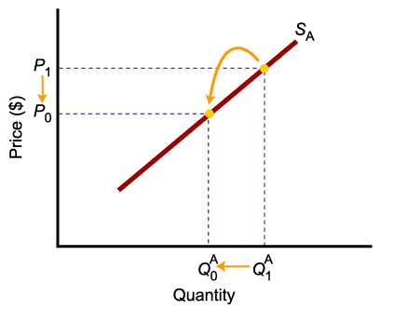
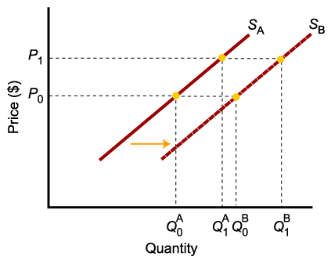
A Change in Supply Versus a Change in Quantity Supplied
To summarize:
Change in price of a good or service
leads to
Change in quantity supplied (Movement along the curve).
Change in costs, input prices, technology, or prices of related goods and services
leads to
Change in supply (Shift of curve).

Slide 13
Supply, Demand and Equilibrium
Equilibrium in a competitive market: when the quantity demanded of a good equals the quantity supplied of that good.
The price at which this takes place is the equilibrium price (a.k.a. market-clearing price):
Every buyer finds a seller and vice versa.
The quantity of the good bought and sold at that price is the equilibrium quantity.

Slide 14
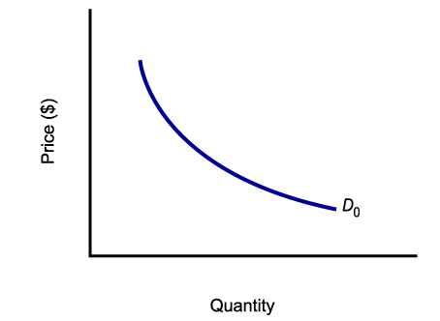
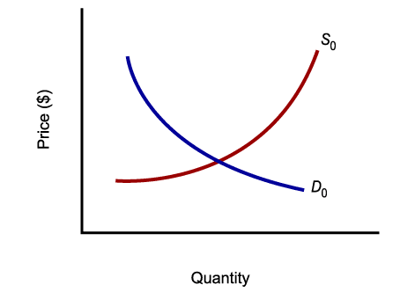
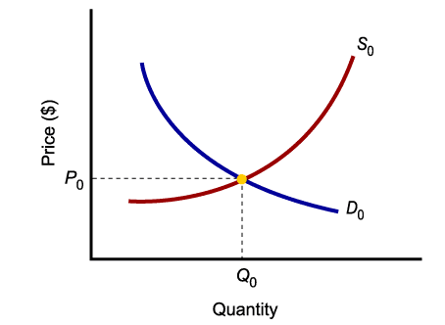
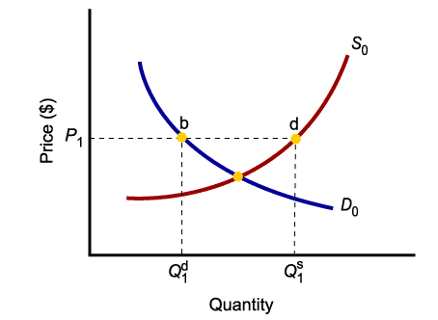
Market Equilibrium
Only in equilibrium is quantity supplied equal to quantity demanded.
At any price level other than P₀, the wishes of buyers and sellers do not coincide.

Slide 15
Surplus
Price of coffee beans (per pound)
There is a surplus of a good when the quantity supplied exceeds the quantity demanded. Surpluses occur when the price is above its equilibrium level.
Supply
$2.00
1.75
Surplus
1.50
1.25
1.00
E
0.75
0.50
Demand
0
7
8.1
10
11.2
13
15
17
Quantity of coffee beans (billions of pounds)
Quantity demanded
Quantity supplied
Notes:
Figure Caption:
Figure 3-12: Price Above Its Equilibrium Level Creates a Surplus
The market price of $1.50 is above the equilibrium price of $1. This creates a surplus: at a price of $1.50, producers would like to sell 11.2 billion pounds but consumers want to buy only 8.1 billion pounds, so there is a surplus of 3.1 billion pounds. This surplus will push the price down until it reaches the equilibrium price of $1.

Slide 16
Shortage
Price of coffee beans (per pound)
There is a shortage of a good when the quantity demanded exceeds the quantity supplied. Shortages occur when the price is below its equilibrium level.
Supply
$2.00
1.75
1.50
1.25
1.00
E
0.75
0.50
Shortage
Demand
0
7
9.1
10
11.5
13
15
17
Quantity of coffee beans (billions of pounds)
Quantity supplied
Quantity demanded
Notes:
Figure Caption:
Figure 3-13: Price Below Its Equilibrium Level Creates a Shortage
The market price of $0.75 is below the equilibrium price of $1. This creates a shortage: consumers want to buy 11.5 billion pounds, but only 9.1 billion pounds are for sale, so there is a shortage of 2.4 billion pounds. This shortage will push the price up until it reaches the equilibrium price of $1.

Slide 17
Market Equilibrium
Price of coffee beans (per pound)
Market equilibrium occurs at point E, where the supply curve and the demand curve intersect.
Supply
$2.00
1.75
1.50
1.25
Equilibrium price
1.00
E
Equilibrium
0.75
0.50
Demand
0
7
10
13
15
17
Equilibrium quantity
Quantity of coffee beans (billions of pounds)
Notes:
Figure Caption:
Figure 3-11: Market Equilibrium
Market equilibrium occurs at point E, where the supply curve and the demand curve intersect. In equilibrium, the quantity demanded is equal to the quantity supplied. In this market, the equilibrium price is $1 per pound and the equilibrium quantity is 10 billion pounds per year.

