Slide 1
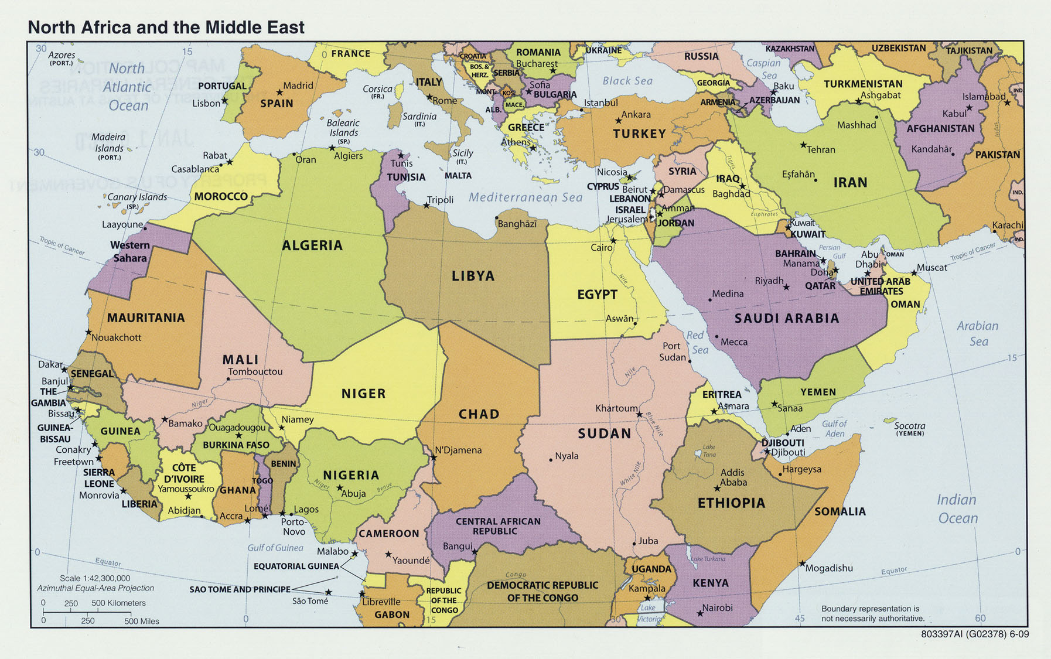

Slide 2
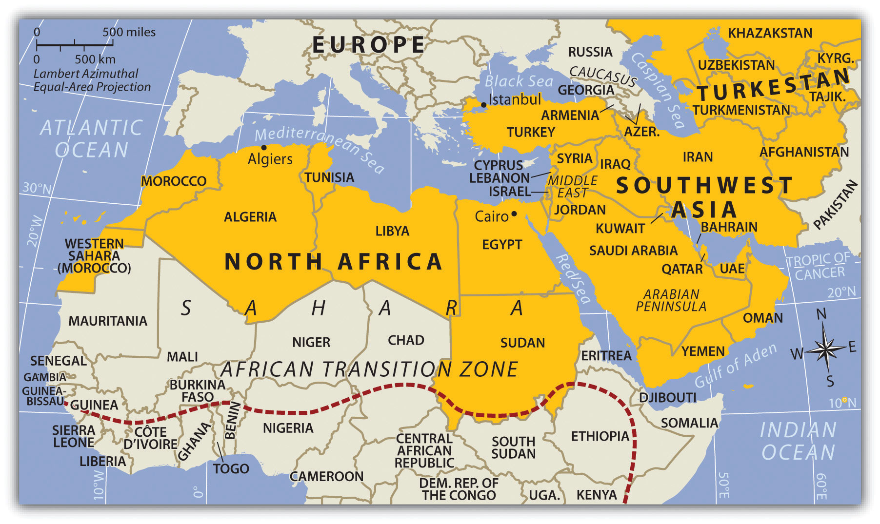

Slide 3
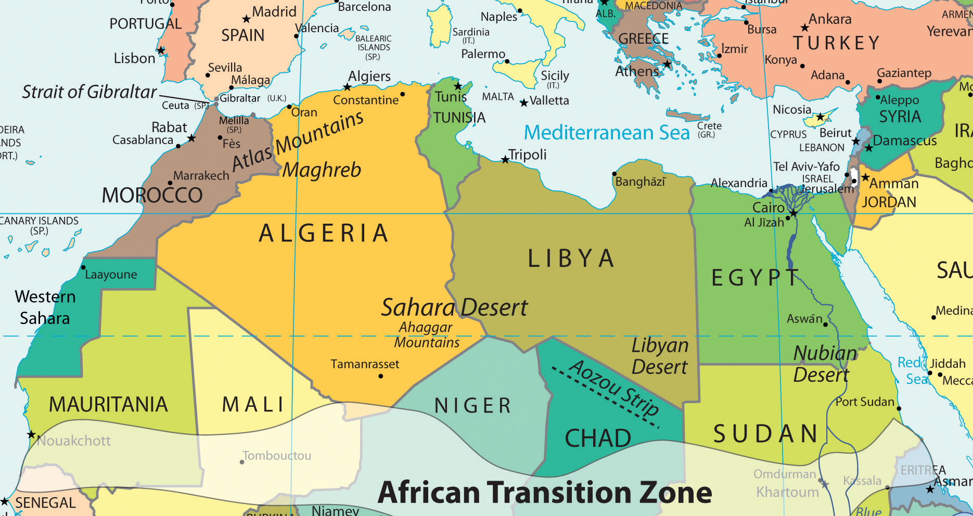

Slide 4
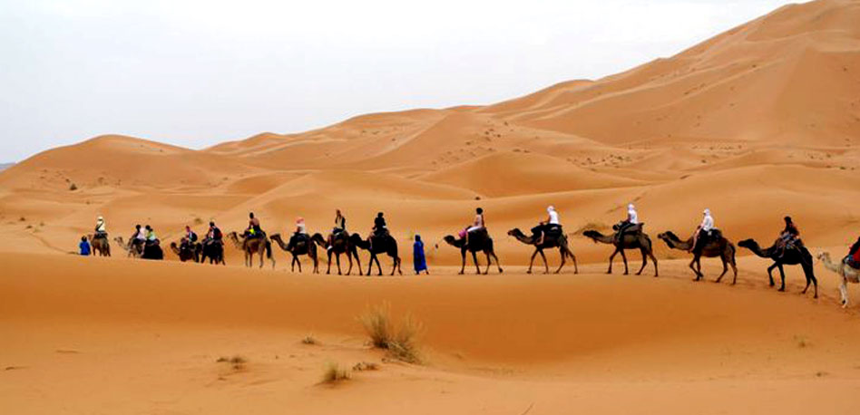
Sahara Desert

Slide 5
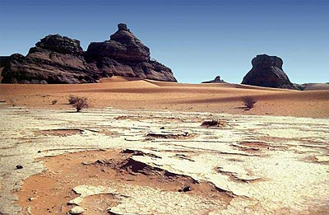
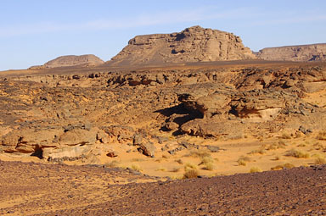
Landforms
North Africa is located at the intersection of four tectonic plates: African, Arabian, Anatolian, and Eurasian. Movement and interaction between these plates have created mountains, shifted landmasses and created earthquakes.
The Atlas Mountains, the region’s tallest mountain range, extend through the area called the Maghreb.
The majority of the Sahara is made up of regs, stony plains covered with rocky gravel, and hamadas, flat sandstone plateaus.

Slide 6
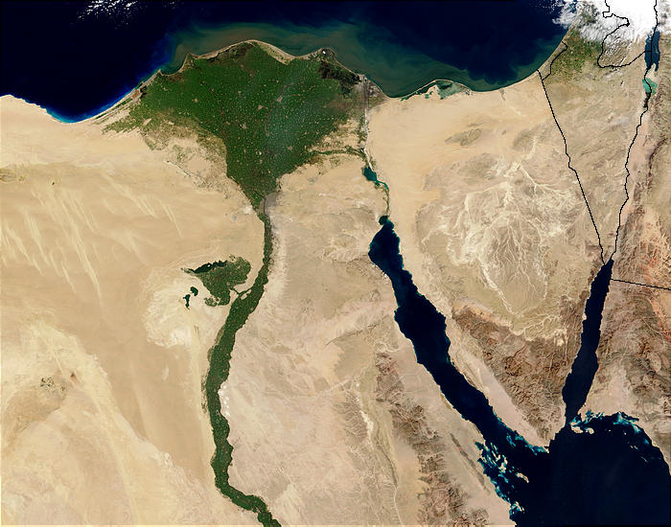
EGYPT AND THE NILE DELTA

Slide 7
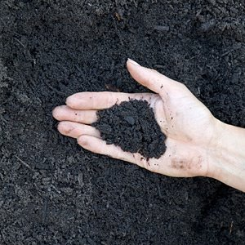
Water Systems
The Nile is the world’s longest river, originating in the highlands of Ethiopia and Uganda.
The fertile land along the banks of the Nile and the Nile Delta gave birth to early civilizations and is now home to more than 90 percent of Egypt’s population.
Until the Aswan High Dam was built, people depended on the annual flooding of the Nile to create rich alluvial soil made up of sand and mud to help grow crops.

Slide 8
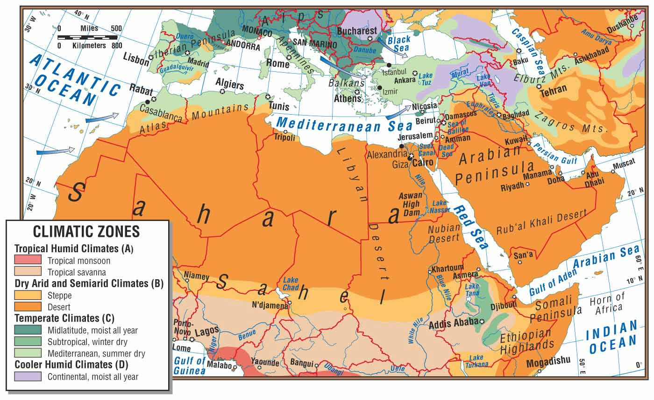

Slide 9
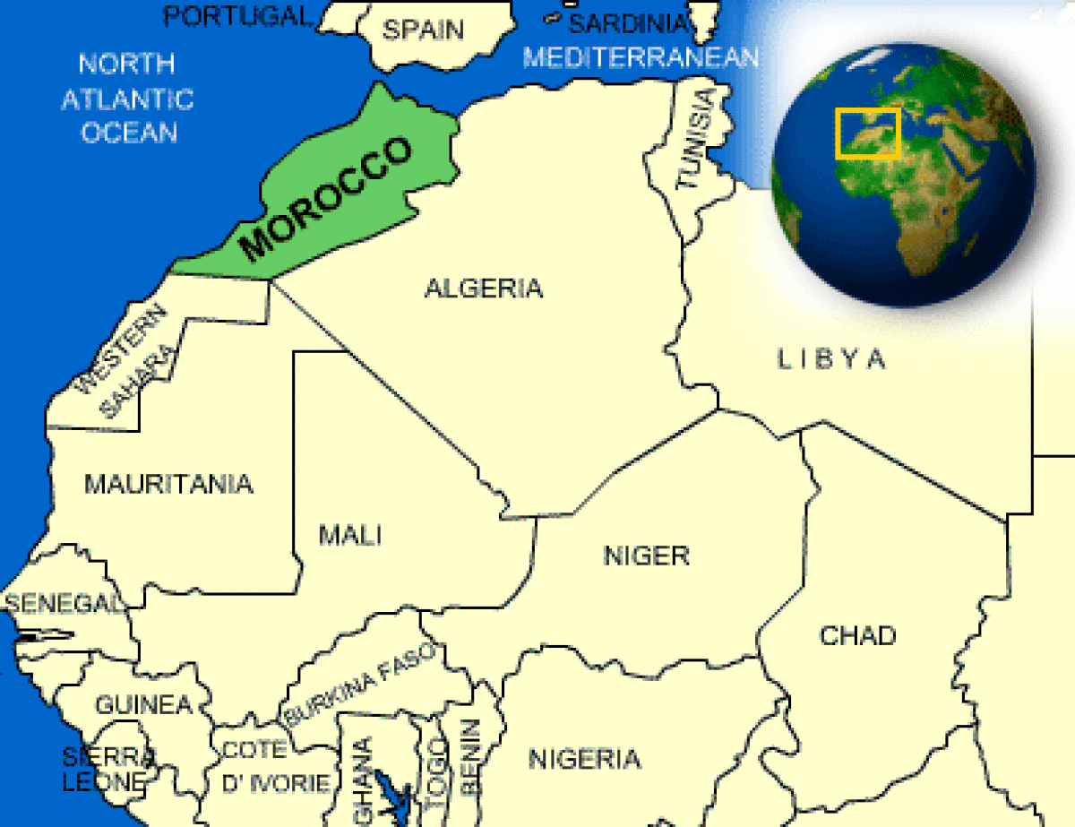
Climate, Biomes, and Resources
North Africa’s climate varies because it is the meeting place of humid and cold air masses that come from the north and hot tropical air masses that come from the south.
The scarcity of water defines the region’s climate and biomes.
Parts of Morocco, Tunisia, and Libya enjoy a Mediterranean climate, with cool, rainy winters and hot, dry summers.

Slide 10
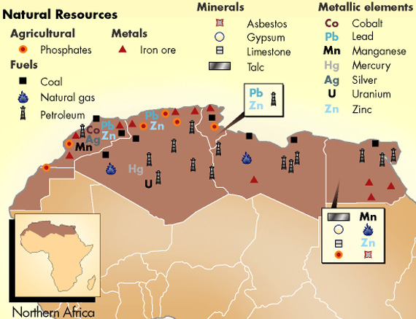
The region’s most significant resources are natural gas, petroleum, and phosphates, a mineral containing chemical compounds used in fertilizers.

Slide 11
Early Peoples and Civilizations
Hunters and gathers settled throughout North Africa 10,000 years ago.
The sub-regions farmers were the first to domesticate plants & animals.
Egyptian civilization developed in the fertile Nile River valley 6,000 years ago. Annual floods deposited rich soil on the floodplain.
Egyptians created irrigation for their crops that enabled them to grow year round.
Egyptians developed a 365 day calendar and a system of writing called hieroglyphics.

Slide 12
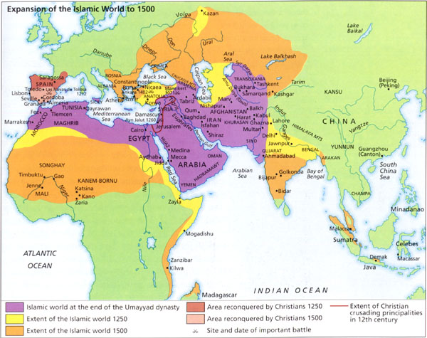
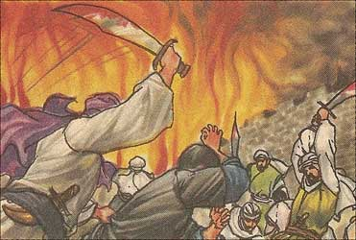
History and Government
Invasions of Arab armies A. D 600 influenced the cultures of North Africa and spread the Muslim religion.
Muslims and Jews fleeing the Inquisition infused Morocco with Spanish culture in the 1400s.
The Ottoman Empire ruled North Africa until the end of World War I in 1918, after which European colonial powers exerted control.
An educated middle class developed feelings of nationalism that provided the basis for the countries that later declared independence.

Slide 13
History and Government
Europe being geographically close began to colonize North Africa in the 1800s.
Algeria was invaded by the French in the 1800s. French influence has been imprinted on the country.
Italy colonized Libya, and France occupied additional territory south of the Atlas mountains.
Europeans started to argue over who would rule North Africa. As a result, European colonial powers drew geometric boundaries that followed straight lines and did not account for natural or cultural features.
The boundaries created conflict between groups of indigenous people.
Problems erupted because local methods of governing differed from European methods.
New North African Middle Class in the later 1800s developed anticolonial ideas and nationalism.
The movement led to demands of self rule that led to modern countries that now emerged.

Slide 14
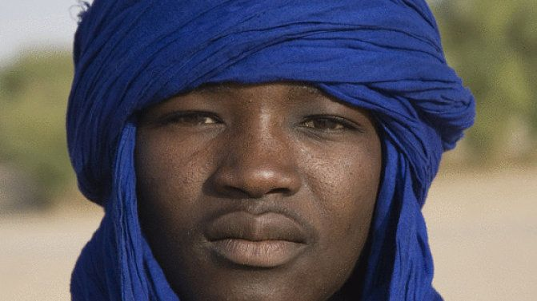
Population Patterns
The area is a mix of Arab cultures with indigenous non-Arab populations such as the Berbers, a formerly nomadic group of people who moved from place to place with herds of animals but who are now largely farmers.
The availability of water greatly influenced settlement, with most people living along the Mediterranean and Atlantic coasts and the Nile River valley.
Emigration rates are high due to greater employment opportunities in other countries and continents.

Slide 15
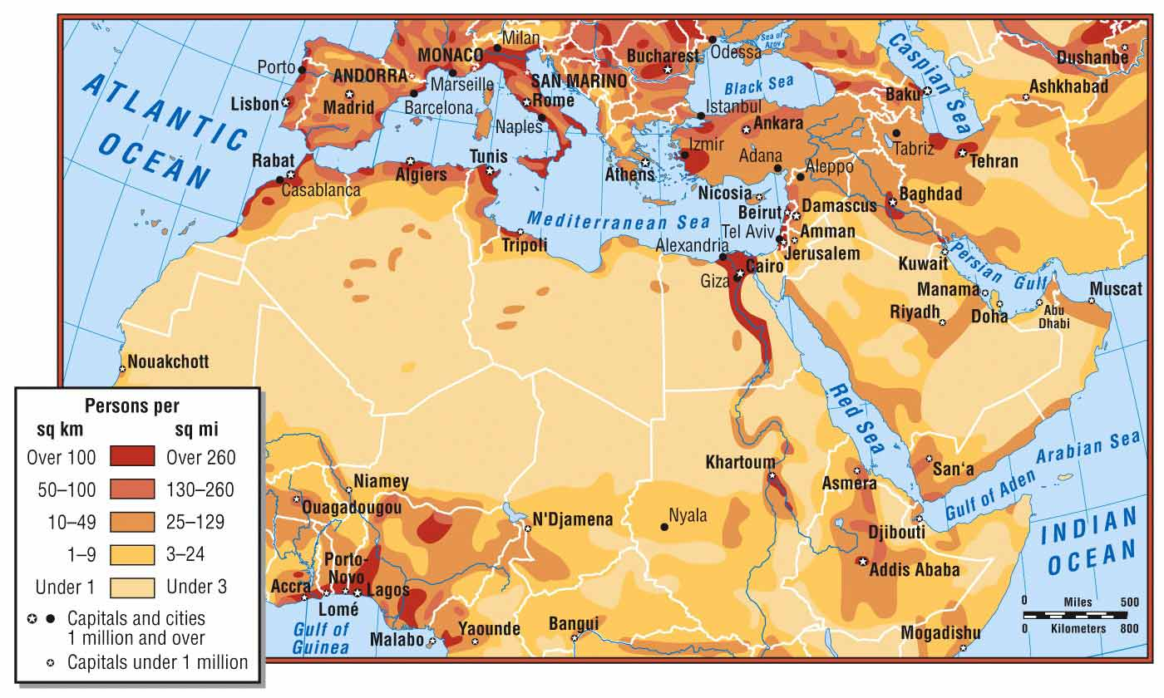

Slide 16
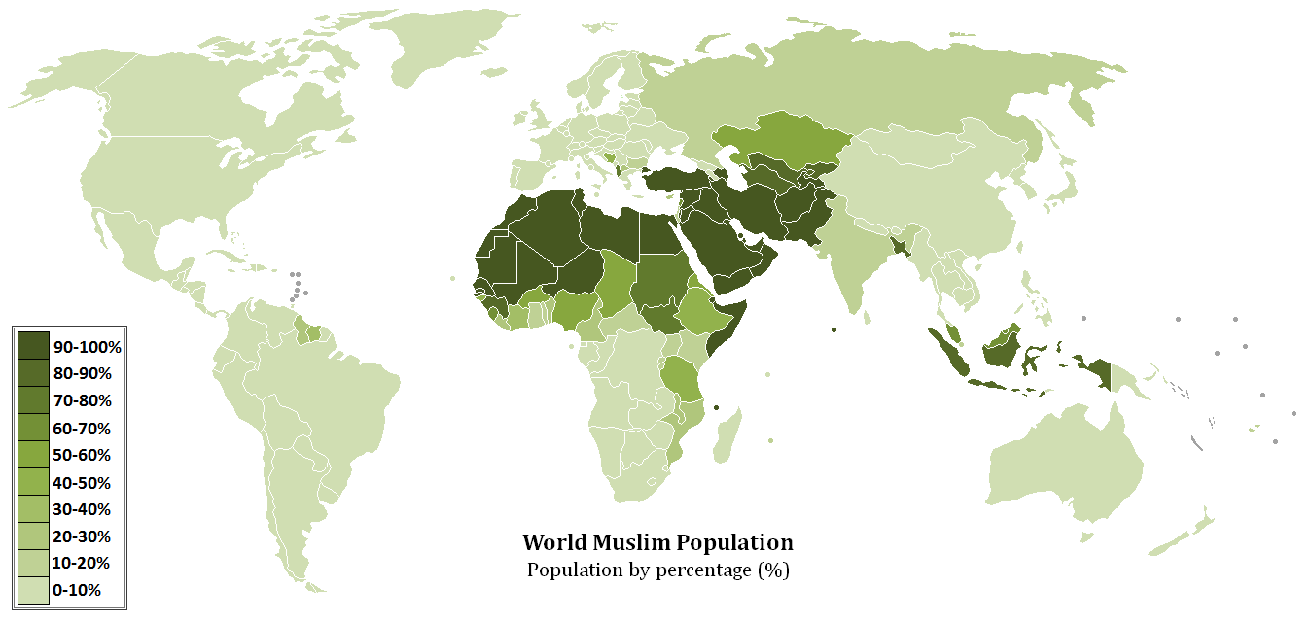

Slide 17
Answer the following questions
The Atlas Mountains, the region’s tallest mountain range, extend through the area called?
When did Europeans begin to colonize North Africa?
As a result of conflict over who would rule North Africa in the 1800s, European colonial powers drew what?
What effect did Arabs invaders have on North Africa?
What caused Europeans to leave their colonies?

Slide 18
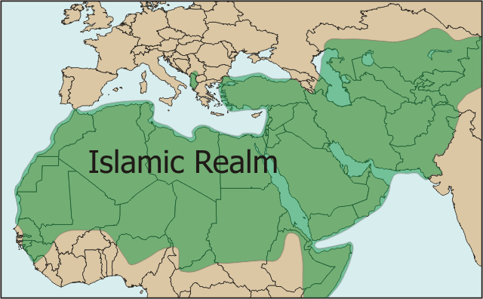
Society and Culture Today
The Muslim religion is the dominant faith.
Arabic is the dominant language in the region, with French used in some areas as a result of colonization.
Class status influences family size, with upper-class families having fewer children than lower-class families.
Human rights are often stifled, with women not permitted to work freely.

Slide 19
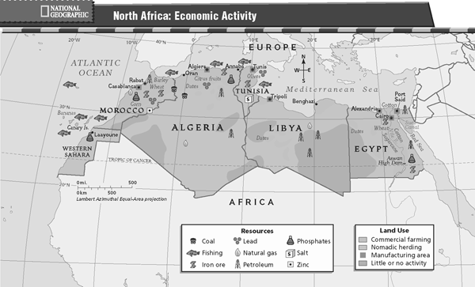
Economic Activities
Economic output varies greatly in the region, with oil and natural gas as the biggest exports.
Agriculture is important in areas with a Mediterranean climate, while fishing is important along waterways.
Despite some economic progress, North Africa suffers from political instability, high unemployment, and poverty.

Slide 20
Managing Resources
The demand for water has increased with population and economic growth.
Much of North Africa’s freshwater comes from rivers, oases, and aquifers, or underground sources of water.
Libya’s Great Man-Made River is an ambitious effort that supplies 70 percent of Libyans with water for drinking and irrigation.
Scientists fear a risk of salinization of the water and the unsustainable rate of extraction.

Slide 21
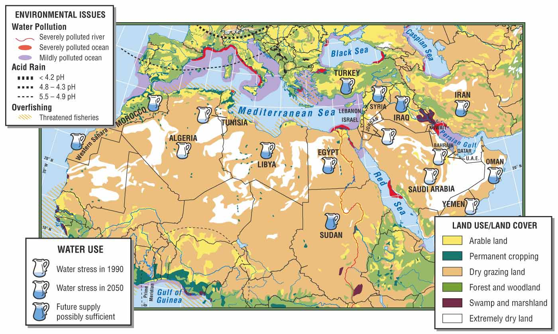

Slide 22
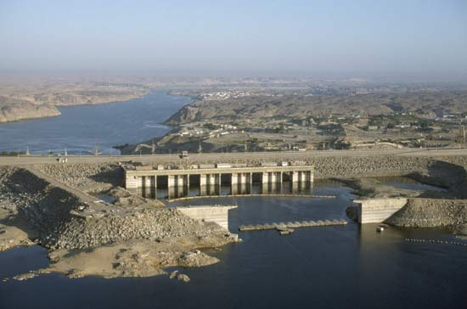
Human Impact
The Aswan High Dam was created to control the Nile’s floods, provide water for irrigation, and generate electricity for Egypt.
The dam has negatively impacted the ecosystem by harming animals and plants, and has increased the likelihood of waterborne diseases.
Population growth, agricultural performance, and environmental degradation are three major concerns that relate to human impact in the region.

Slide 23
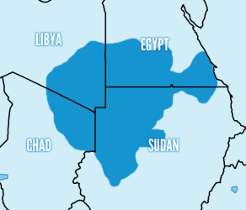
Addressing the Issues
Cooperation among countries can settle issues of fluctuating oil supplies and help establish preventative measures for spills and cleanup.
A joint authority encourages cooperation in managing water resources, like the Nubian Sandstone Aquifer System.
At the international level, the World Bank is developing plans to invest in modern irrigation practices for agriculture.

