Slide 1
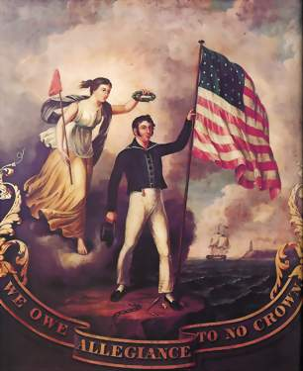
Chapter 5 American Nationalism

Slide 2
Opening Quote
“
In one of his first major decisions on trade policy, President Obama opted Friday to impose a tariff on tires from China, a move that fulfills his campaign promise to 'crack down' on imports that unfairly undermine American workers but risks angering the nation's second-largest trading partner. The decision is intended to bolster the ailing U.S. tire industry, in which more than 5,000 jobs have been lost over the past five years as the volume of Chinese tires in the market has tripled.
”
—Washington Post, September 12, 2009
How do tariffs affect the economy, people, and workers?

Slide 3
Definitions
Economy: the wealth and resources of a country or region, especially in terms of the production and consumption of goods and services.
Tariff: a tax or duty to be paid on a particular class of imports or exports.
Internal: of or situated on the inside.
Interpreting: explain the meaning of (information, words, or actions).
Interstate: existing or carried on between states.
Diplomacy: the profession, activity, or skill of managing international relations, typically by a country's representatives abroad.
Doctrine: a stated principle of government policy, mainly in foreign or military affairs.
Alliance: a union or association formed for mutual benefit, especially between countries or organizations.
Urban: in, relating to, or characteristic of a city or town.
Rural: in, relating to, or characteristic of the countryside rather than the town.
Havens: a place of safety or refuge.
Thrived: prosper; flourish.
Dominated: have a commanding influence on; exercise control over.
Ambiguous: unclear or inexact because a choice between alternatives has not been made.
Coping: to struggle or deal, especially on fairly even terms or with some degree of success.
Opponents: someone who competes against or fights another in a contest, game, or argument; a rival or adversary.
Controversy: disagreement, typically when prolonged, public, and heated.
Procedure: an established or official way of doing something.
Secede: withdraw formally from membership in a federal union, an alliance, or a political or religious organization.
Sovereign: possessing supreme or ultimate power.

Slide 4
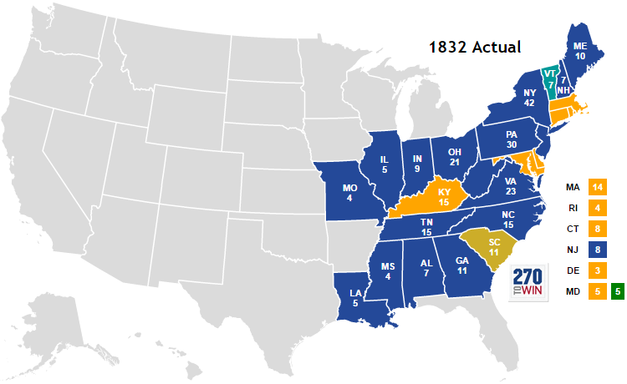

Slide 5
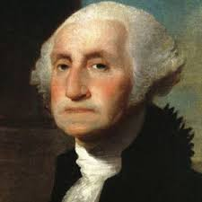
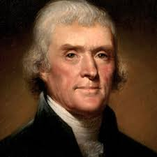
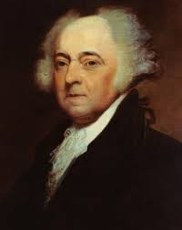
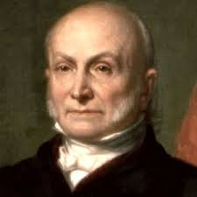
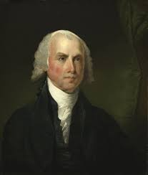
AMERICAN PRESIDENTS
George Washington 1789-1797
John Adams 1797-1801
Thomas Jefferson 1801-1809
James Madison 1809-1817
John Quincy Adams 1825-1829

Slide 6
Economic Nationalism
After the War of 1812 there was a strong sense of national pride that spread throughout the nation.
With no national bank to regulate currency inflation started to set in.
After the War of 1812 the government had to pay high interest rates on the loans to pay for the war. As a result, the congress approved a second national bank.
After the War of 1812 inexpensive British goods threatened to put American manufacturers out of business.
Congress passed the Tariff of 1816.
This was not a revenue tariff that provided income for the federal government. It was a protective tariff that raised the prices of imports to help support American manufacturers.

Slide 7
Judicial nationalism
Between 1816 and 1824 the Supreme Court under chief Justice John Marshall issued several rulings that helped unify the country after the war of 1812.
Martin vs. Hunter’s lessee
In 1816 the Court decided it had the authority to hear all appeals of state court decisions in cases involving federal statues and treaties. It happened because Denny Martin a British citizen had tried to sell land in Virginia he had inherited. The state law said no enemy could inherent land. The Supreme Court ruled Virginia’s law conflicted with Jay’s Treaty that allowed lands belonging to Loyalists before the war would still be able to keep it.
McCulloch vs. Maryland
In 1819 Maryland attempted to tax the Second National Bank. The Court addressed the authority of the federal government to create a national bank stating the Constitution grants this under the “Necessary and Proper Clause.”
The Court decided the federal government was “supreme in its own sphere of action.” Meaning a state government could not interfere with an agency of the federal government operating within the state’s boarder.
Gibbons vs. Ogden
A case in 1824 where a company was granted a monopoly by the state of New York to control all steamboat traffic on New York waters who tried to expand into New Jersey. The Court declared the monopoly unconstitutional.
The Constitution grants the federal government control over interstate commerce.

Slide 8
Nationalist Diplomacy
The wave of nationalism influenced the nation’s foreign affairs.
Florida was under the control of the Spanish empire.
Southerners were angry because slaves would escape and go to Florida where slavery was banned. Additionally, Southerners were banned from going into Florida and recapturing the slaves.
The Creek tribe seized the lands of American settlers along the borders.
Many tribes united with other tribes and adopted the name Seminole.
The Seminoles in Spanish Florida and in Georgia started raiding the areas.
In 1817 John C. Calhoun the Secretary of War ordered General Andrew Jackson into Florida to stop the Seminole raids. After destroying several Seminole villages, Jackson disobeyed orders and seized the Spanish settlements of St. Marks and Pensacola, and removed the Spanish governor of Florida.
The Spanish were angry and demanded Jackson leave and be punished. Our government said no because they have not did the job of governing their territory.
Spain gave in and ceded all of Florida to the USA in the Adams-Onis Treaty of 1819. The treaty finalized the western boarder of the Louisiana Purchase.

Slide 9
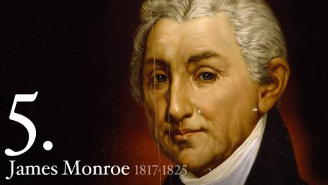
Monroe Doctrine
Do to land disputes between European nations in the Americas President Monroe declared the American continents were not to be colonized anymore.
The policy started the beginning of a long term American policy of trying to prevent further powers from interfering in Latin American political affairs.

Slide 10
A Revolution in Transportation
The Erie Canal connected the Hudson River at Albany to Lake Erie at Buffalo.
In 1806 Congress started a National road. The road reached from the Potomac River to Wheeling West Virginia. It was only federally funded project at the time because the government believed roads were the responsibility of the state and local governments.
Steamboats and Canals
Rivers were used to transport goods. However, they could only move downstream.
The steamboat created by Robert Fulton made river travel more reliable and upstream travel possible.
By 1850 700 steam boats traveled along the nation’s waterways.
The Iron Horse
Between 1830 and 1861 the nation laid more than 30,000 miles of railroad track boosting the demand for coal and started to make travel quicker and brining the country together.

Slide 11
A New System of Production
The Industrial Revolution started in Great Britain in the 1700’s shifting people from making things with hand tools to large, complex machines. Skilled artisans gave way to unskilled workers, and factories replaced home based workshops.
The Industry developed quickly in the United States for several reasons:
The American free enterprise system allowed individuals to make money and decide how to use it without strict government controls it encouraged innovation. It created competition and entrepreneurial creativity.
Industrialization began in the Northeast where many streams and rivers could provide textile mills with waterpower.
Entrepreneur Francis C. Lowell began opening a series of textile mills in northeastern Massachusetts in 1814.
Industrialists also applied factory techniques to producing lumber, shoes, leather, wagons, and other products.

Slide 12
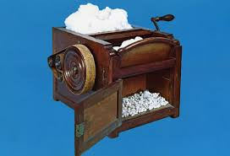
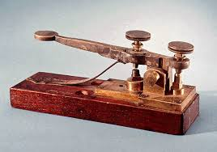
Technological Advances
Eli Whitney invented the Cotton Gin.
He also popularized the concept of Interchangeable parts.
It transformed gun making. Using this process machines made large quantities of identical pieces that workers assembled into finished goods.
Communications improved because the invention of the telegraph. It started quick reliable long distance communication.

Slide 13
The Rise of Large Cities
Industrialization drew rural people to towns in search of jobs. The population of many cities doubled or tripled. New York was the nation’s largest city in the 1820s.
Workers Begin to Organize
The industrial boom created a new kind of laborer, the factory worker. As factories grew in size they faced working long hours, lower pay and unsafe work conditions.
As a result, some workers began to join labor unions. Most unions were local and focused on a single trade. They pushed for similar changes such as higher wages and shorter work days.
During this time unions did not have much effect.
Unions made some gains in 1840 when President Martin Van Buren reduced the workday to 10 hours.

Slide 14
Life in the North
The population growth in urban centers led to rising crime and labor riots. As a result, many cities established police departments. They also started fire departments.
Sanitation was a problem because garbage and human waste was not being disposed of.
Diseases such as cholera and typhoid broke out in crowed areas. It led to improvement in sanitation such as sewer systems and trash pickup.
Public education was limited. However 80 percent of the population was literate because they were taught at home. Rich families could afford to pay for private schools and for college.
Northern cities became havens for runaway enslaved people as well as free African Americans, but most African Americans remained poor.
In cites with larger African American populations such as New York and Philadelphia a small middle class emerged.
Although urban centers mostly employed people in factory workers, most in the north were still farmers and sold their access crops to the cities.

Slide 15
The Southern Economy
The South’s economy heavily relied on cash crops such as tobacco and rice.
The invention of the Cotton Gin helped increase the production of cotton and with the boom of the Industrial Revolution it created a lot of wealth for the South.
Cotton Becomes King
By the late 1840s Southerners were producing more than 2 million bales of cotton annually.
The exports of cotton sold for more than half the value of all U.S exports.
This led to the strengthening of slavery in the South.
The South became rich from agriculture and it did not industrialize as fast as the North. The South remained mostly rural.
Society in the South
The South’s economy resulted in a society with a rigid and clearly defined class structure. At the top of Southern society was the planter elite who owned the larger plantations.

Slide 16
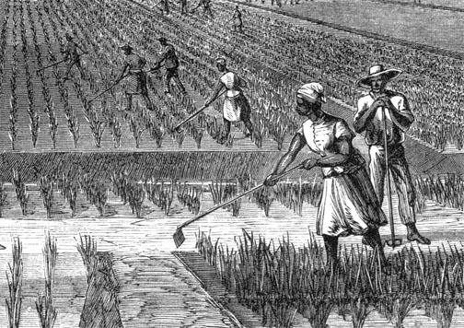
Slavery
Rice and cotton plantations, as well as tobacco farms depended on enslaved labor. The vast majority of enslaved African Americans worked in the South’s fields.
Enslaved people had few legal rights. State codes forbade enslaved people from owning property or leaving a slaveholder’s premises without permission.
They could not bring a lawsuit or sign a contract.
They could not possess guns or testify in court against a white person.
Laws banned them from learning to read and write. Society viewed enslaved people as property.

Slide 17
Plantation Life
On farms and small plantations that held few enslaved people the task system was used to organize enslaved labor. Under this system workers were given a specific set of jobs to accomplish every day.
After completing their tasks, they were allowed to spend the remainder of the day as they chose. Some slaves earned money making things. Others cultivated personal gardens or hunted for extra food.
Enslaved Women and Children
Women worked long hard days in the fields or in the plantation house. They served as maids, nannies or cooks. Where family relationships were allowed they cooked and cared for their own families.
Children of enslaved parents might be allowed to play with the plantation owner’s children, but as soon as they were able they were given work. Most enslaved children were prevented from getting an education, although some learned to read.

Slide 18
Free African Americans
Some 250,000 free African Americans lived in the South by the time of the Civil War.
The majority lived in rural areas.
Some had earned their freedom through service in the American Revolution and others were half white children of slaveholders who had freed them. Others managed to purchase their freedom for themselves and their family.
Coping with Enslavement
From language to music and religion African Americans developed a culture that provided them with a sense of mutual support.
Many enslaved people found ways to oppose the lives forced on them. Some would stage work slowdowns. Others broke tools or set fire to house and barns and others ran away.
The first major slave uprising happened in 1800 by an enslaved man named Gabriel Prosser. He organized other slaves and made their own weapons.
They planned to capture Richmond and kill all whites living there with the exception of the French who were living there. The plot was discovered and the state militia of Virginia was sent. They captured Prosser and the other leaders and executed them.

Slide 19
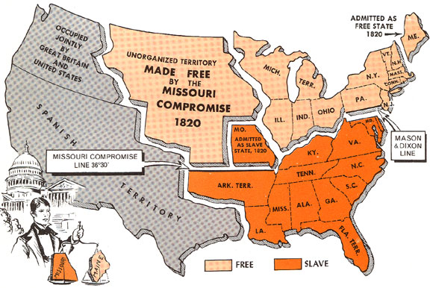
The Missouri Compromise
In 1819 controversy erupted over Missouri’s application for admission to the Union as a slave state. At the time the Union consisted of 11 Free states and 11 slave states.
It would create two problems: 1) it would create an unbalance in the Senate. 2) It would extend slavery into the northern part of the Louisiana territory.
The solution was to allow Maine to become a state and break off from Massachusetts. Then an amendment prohibited slavery in the Louisiana territory north of Missouri’s southern border.

