Slide 1
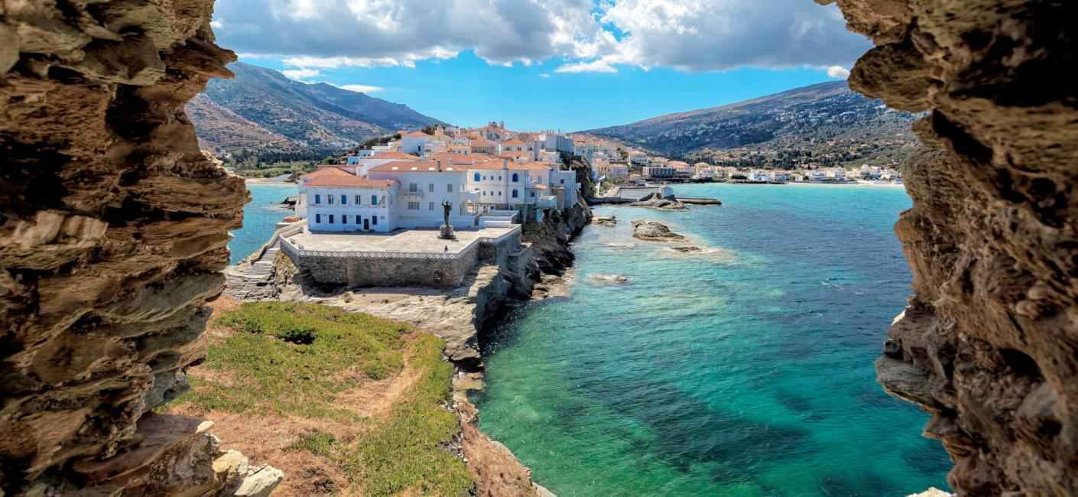
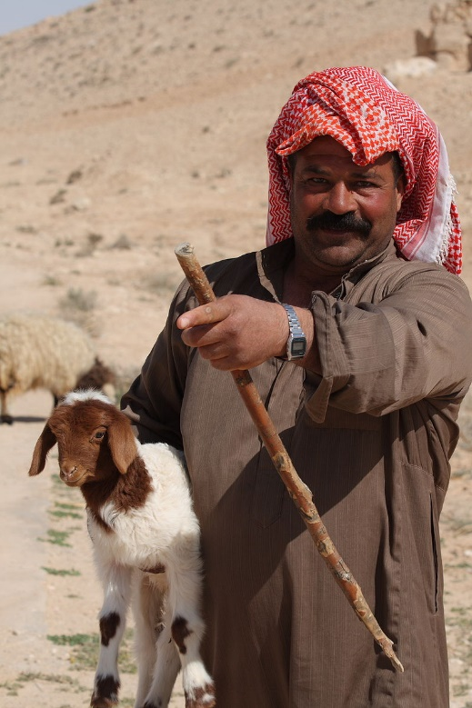
Chapter 16 ~ Eastern Mediterranean

Slide 2
Physical Geography of the Eastern Mediterranean

Slide 3
Physical Geography of the Eastern Mediterranean
Landforms
This area is known as the Levant and includes Syria, Jordan, Lebanon, Israel, and the Palestinian territories.
The area is marked by mountains and deserts and has a generally temperate climate. Meaning temperate and weather is very consistent.
The sparsely populated Anti-Lebanon mountain range runs along the border between Syria and Lebanon.
The Syrian Desert is composed of gravel and used as a roadway.

Slide 4
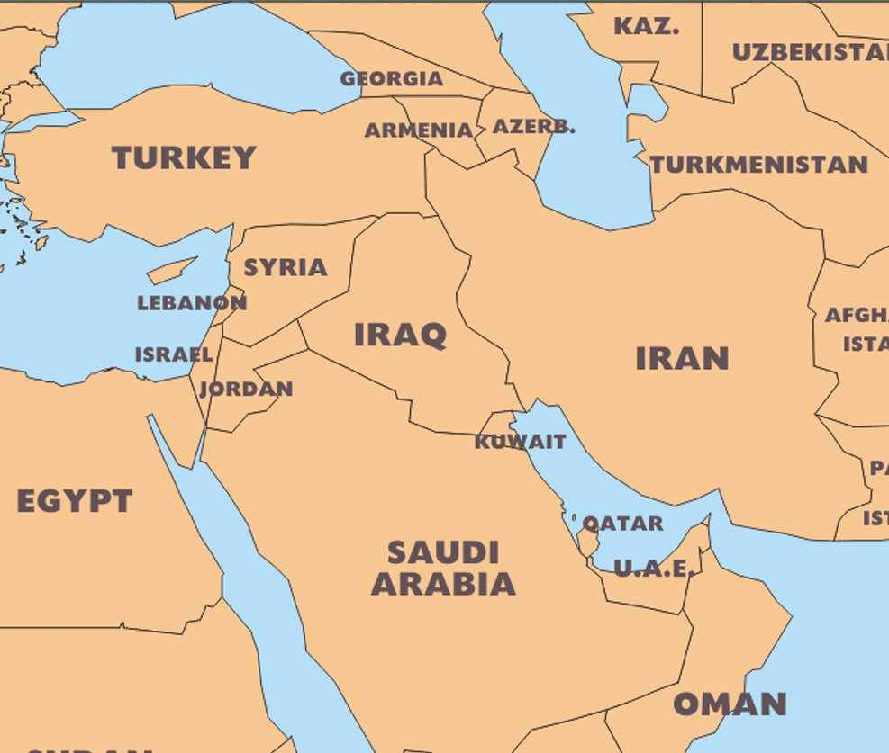
The Levant

Slide 5
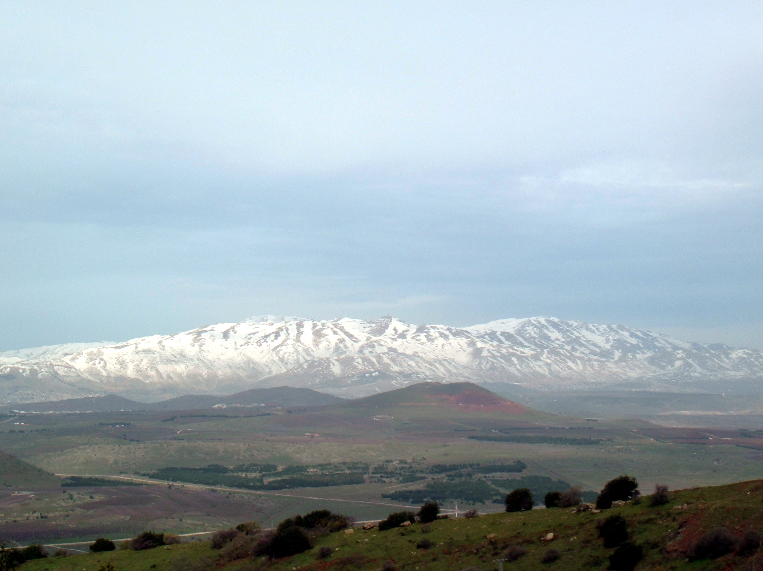
Anti-Lebanon Mountains form the majority of the border between Syria and Lebanon. Very low populations. Nomadic herders travel the region.
The highest point is Mount Hermon at 9,232 feet.

Slide 6
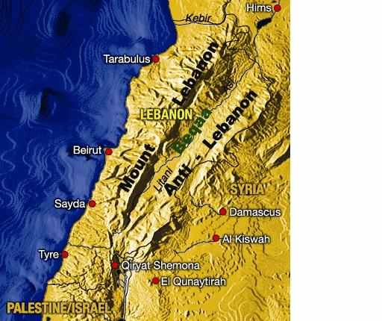

Slide 7
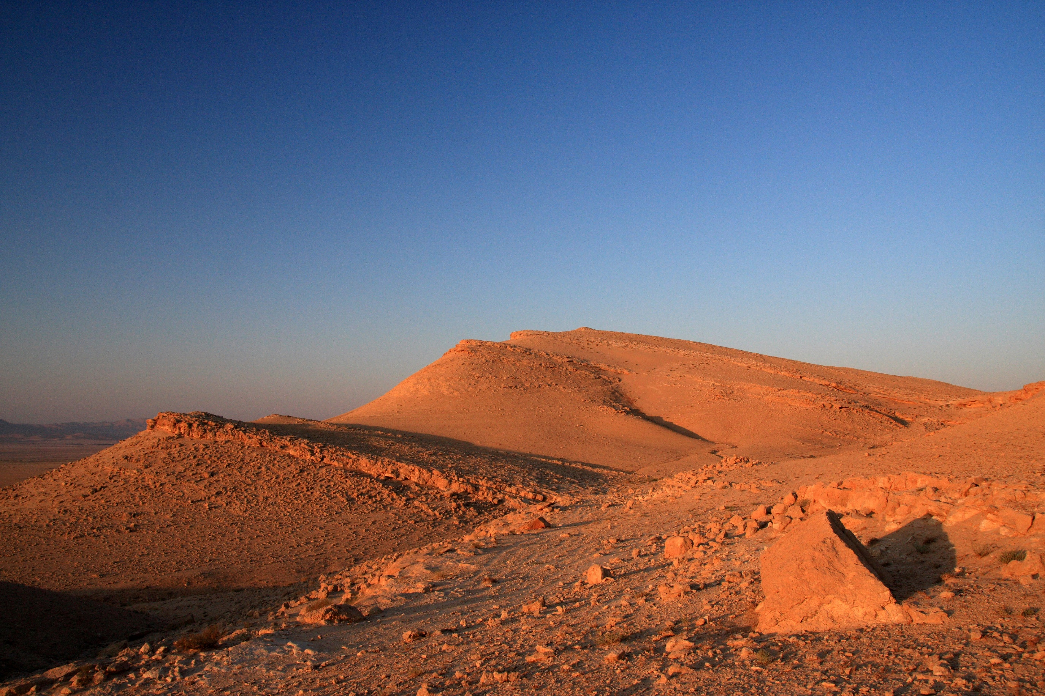
Syrian Desert

Slide 8
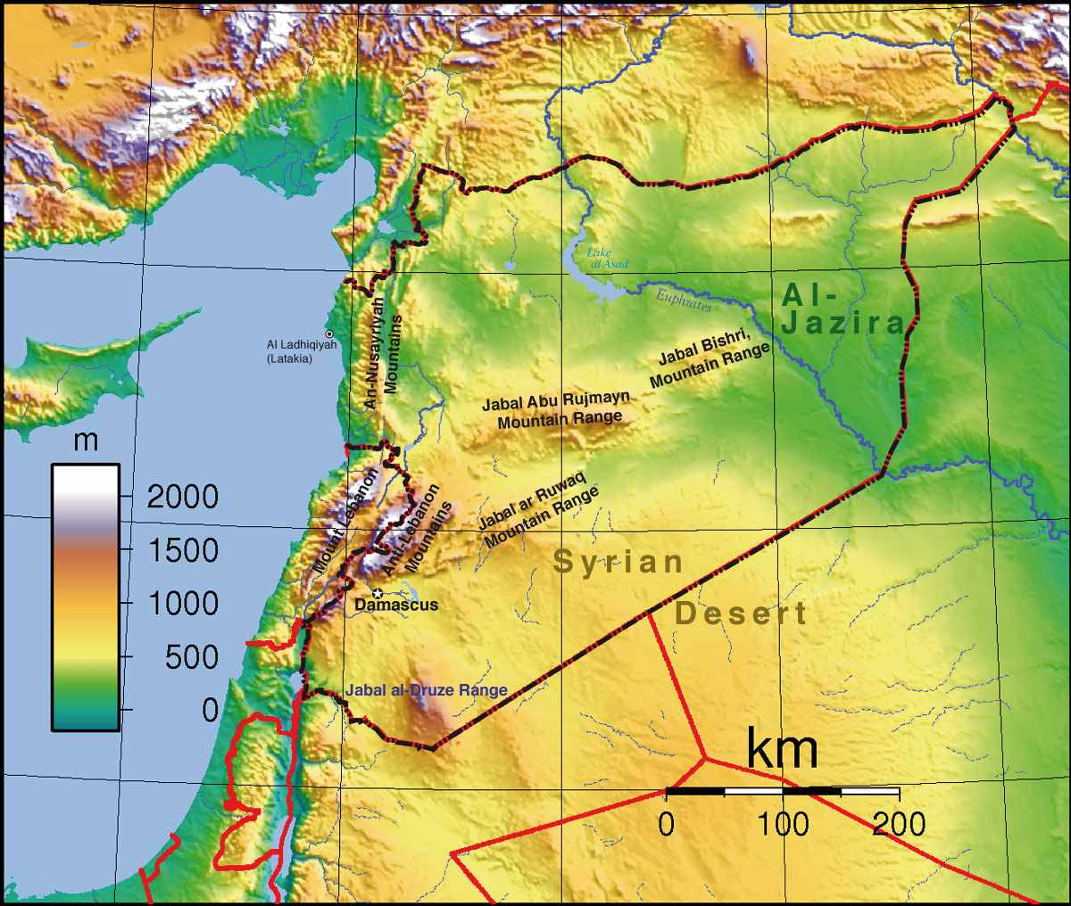
v
TURKEY
SYRIA
IRAQ
JORDAN
SAUDI ARABIA

Slide 9
Physical Geography of the Eastern Mediterranean
Water Systems
The Euphrates River is the most important river in Syria and provides the entire country with water.
Important for irrigation and agriculture, the Jordan River flows through all the countries in the sub region and provides a natural border between the West Bank and Jordan.
The Gulf of Aqaba connects the sub region with the Red Sea and Indian Ocean.

Slide 10
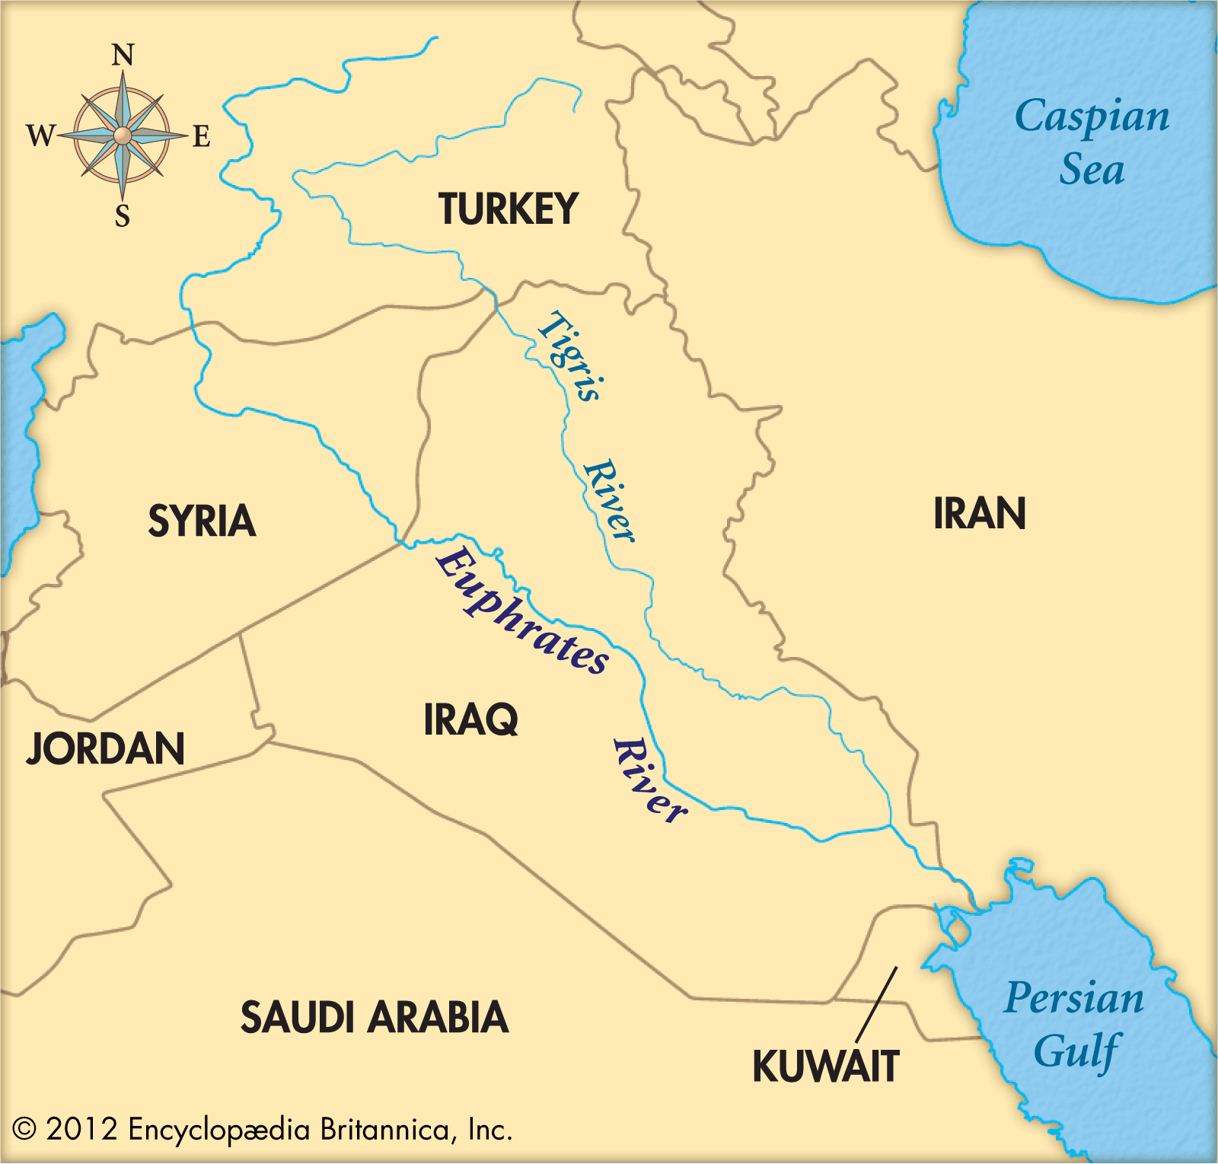

Slide 11
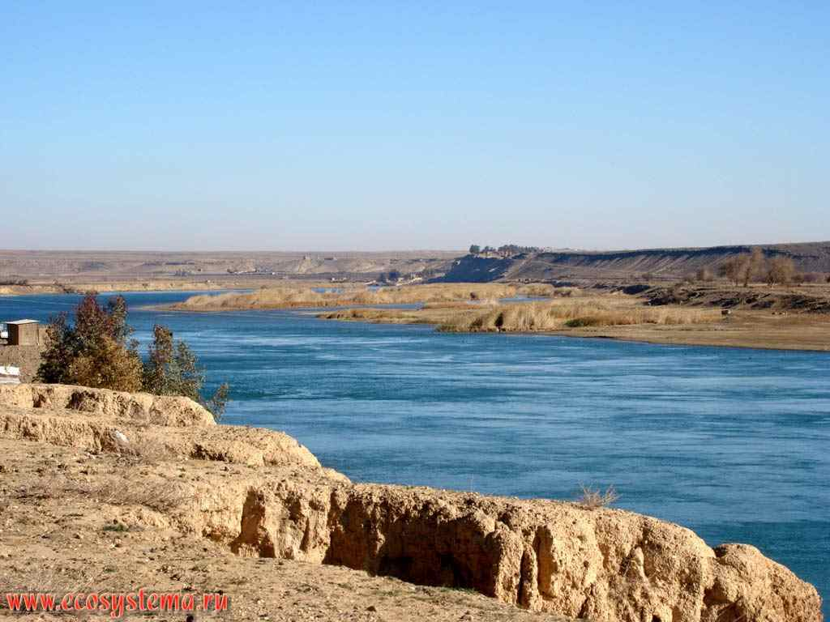
Euphrates River – eastern Syria

Slide 12
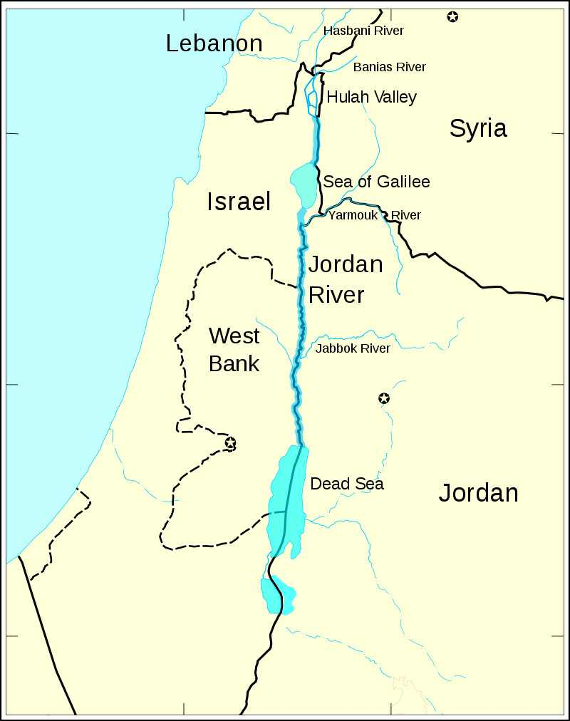

Slide 13
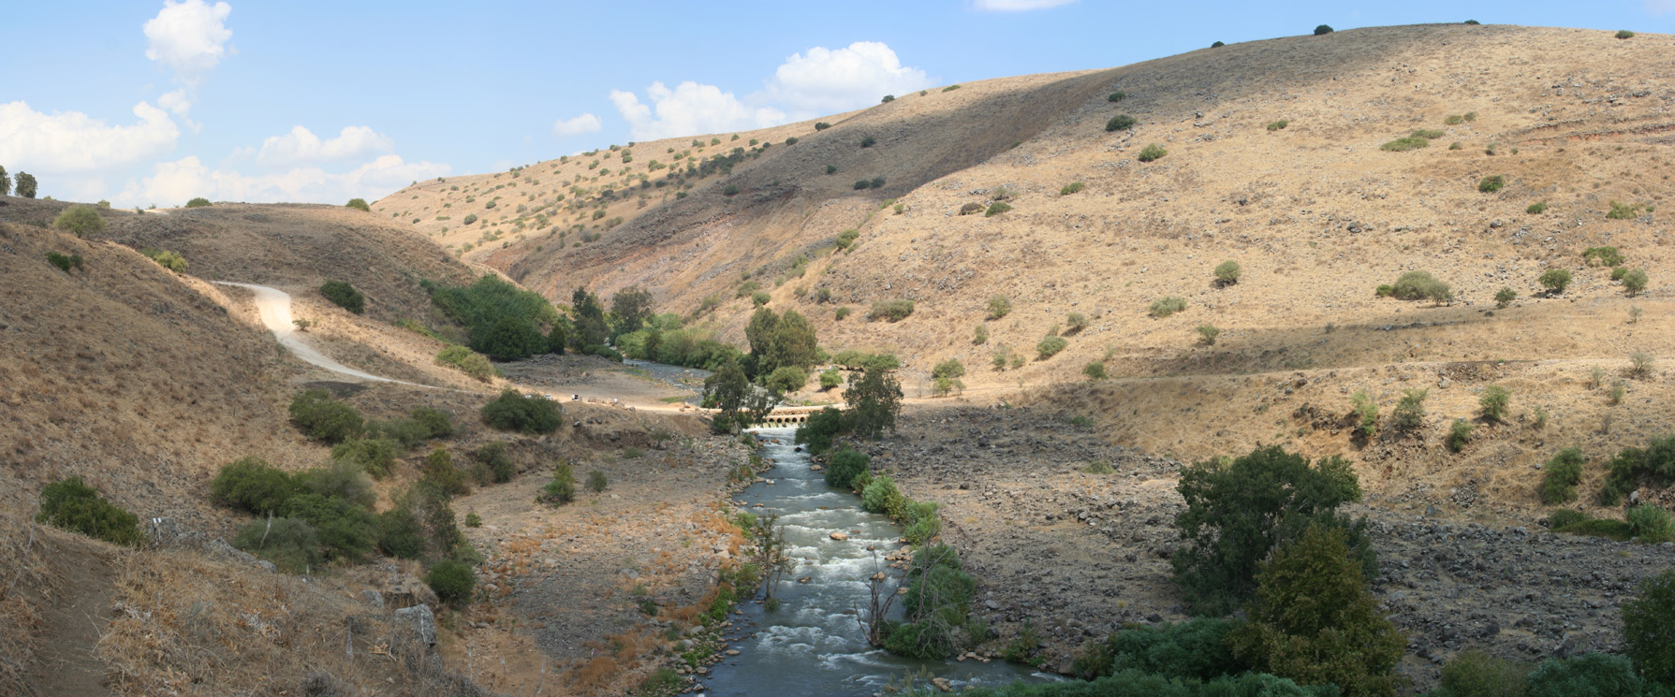
Jordan River

Slide 14
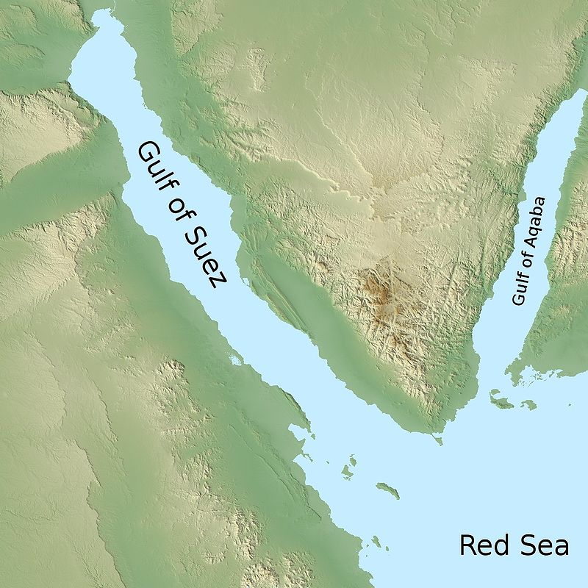
Sinai Peninsula

Slide 15
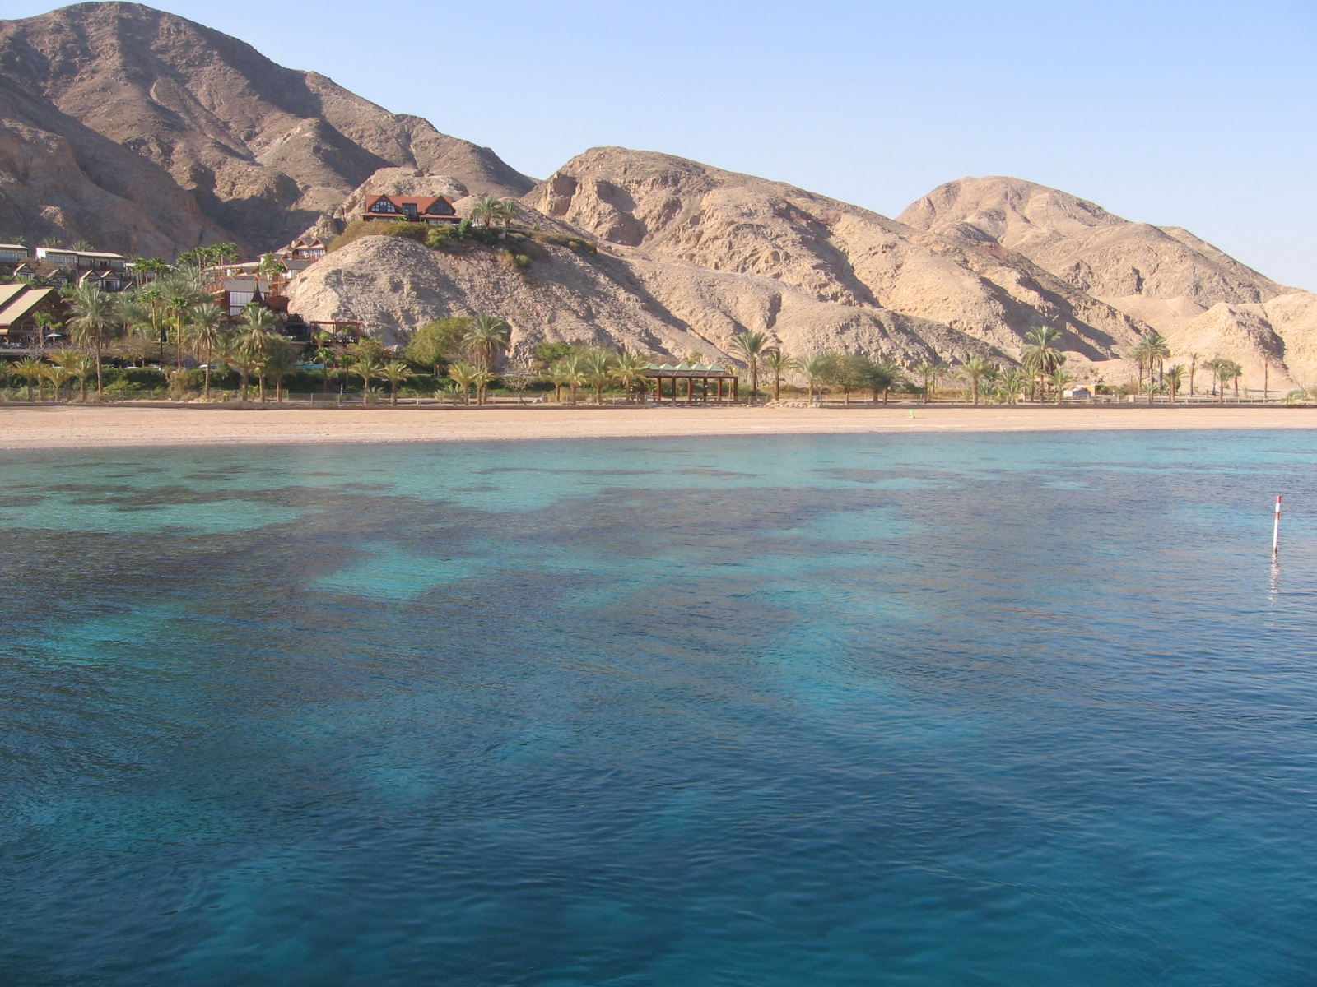
Gulf of Aqaba

Slide 16
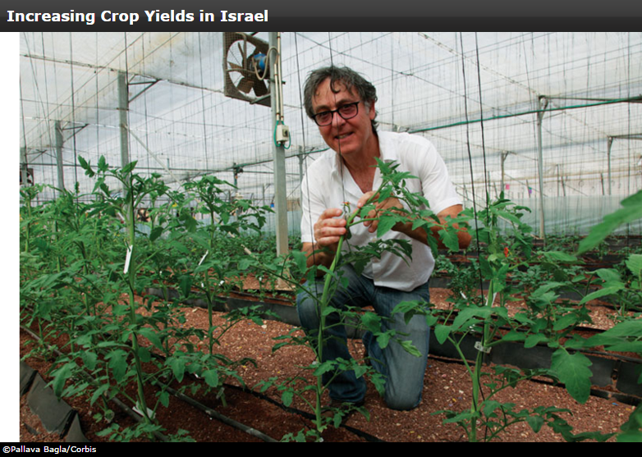
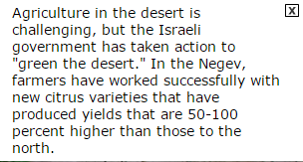

Slide 17
Physical Geography of the Eastern Mediterranean
Climate, Biomes, & Resources
Rainfall is limited in the sub region, which consists of mostly semi-arid and arid climates.
The coastal regions have a Mediterranean climate that supports agriculture, and a wide array of vegetation and wildlife.
As one moves inland, the climate becomes humid subtropical, then shifts to semi-arid steppe and arid desert.

Slide 18
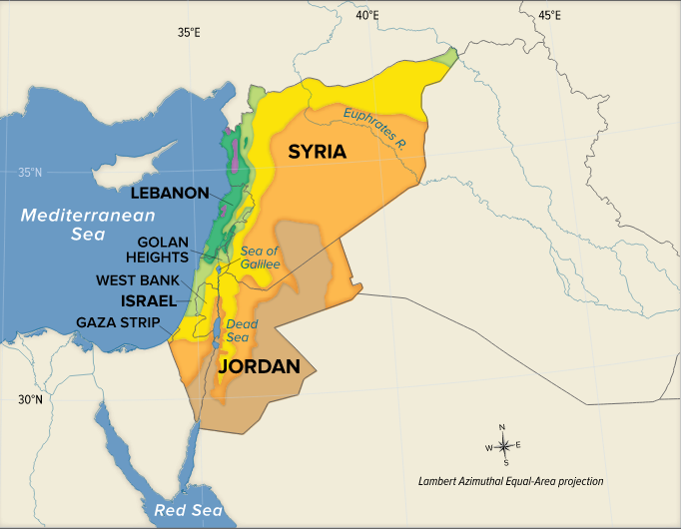
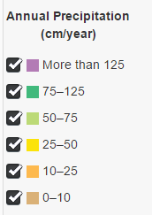

Slide 19
Natural Resources
Lumber and minerals are important natural resources in the sub region.
Many of the countries were once had forests but most are gone.
Cedar trees are the most prized because of their fragrance and commercial value.
Minerals are plentiful such as gypsum and marble.
Israel has farming communities known as Kibbutz and Moshav.
Biggest challenge of the region is fresh water.

Slide 20
Human Geography of the Eastern Mediterranean
Population Patterns
The dry, desert climate causes most people to live along the coastal plains.
Many ethnicities and religious sects reside in the sub region.
Demographics have changed drastically in the past century, with Israel experiencing a large migration of Russian Jews and the displacement of Palestinians following the establishment of the Israeli state.

Slide 22
Israel: Land for Jews
Israel is a modern, democratic nation created in 1948.
It was conceived as a homeland for Jews who had experienced discrimination worldwide.
Israel includes Jews and Arabs, who have rights of citizenship.
Israel was the historic homeland of the Jews first promised by God to Abraham around 2000 BCE.
Israel was the site of several kingdoms and independent states until the Romans finally exiled the Jews in 135 AD.
During the Diaspora, Jews remembered their homeland and dreamed of returning to it.

Slide 23
Relative location:
Israel is at the crossroads between Asia, Africa, and Europe.
The area’s small size limits its capacity to be a homeland for all the people who want to live there.
Soon after World War II, armed conflicts broke out among Jewish and Arab ethnic groups in the Palestine.

Slide 24
Palestine: Homeland for Palestinians
Palestinians are the Arabic speaking people that live in Palestine.
Most Palestinians practice Islam which came to Palestine around 638 AD, although some are Christian.
Jerusalem is one of the most holy cities for Islam because Moslems believe that Muhammad ascended to heaven here

Slide 25
CREATION OF ISRAEL
The Jews wanted an internationally recognized homeland in a part of Palestine. The Palestinians wanted all of Palestine.
The Jews accepted a 1947 United Nations (UN) plan to divide Palestine into a Jewish state and an Arab state.
The Arabs rejected it, thus setting up a struggle for control of the land.
Both groups had a deep religious and ethnic attachment to the land. The British withdrew from the disputed Palestinian territory, and the Jews proclaimed the independent state of Israel in May 1948.

Slide 26
First Arab Israeli War
May 15, 1948: Neighboring Arab nations (Egypt, Syria, Lebanon, Jordan and Iraq) attacked Israel
August 1949: Israel won the war and occupied 30% more of land the UN had given to Palestinians
Egypt and Jordan occupied the rest of Palestinian land
Egypt took control of the Gaza Strip
Jordan annexed the West Bank.
700,000 Palestinians became refugees
Most fled to Jordan, the West Bank or the Gaza Strip
Over next few years 900,000 Jews immigrated to Israel
Notes:
Truman rejects advice of George Marshall, who was worried that action would anger Arab states

Slide 27
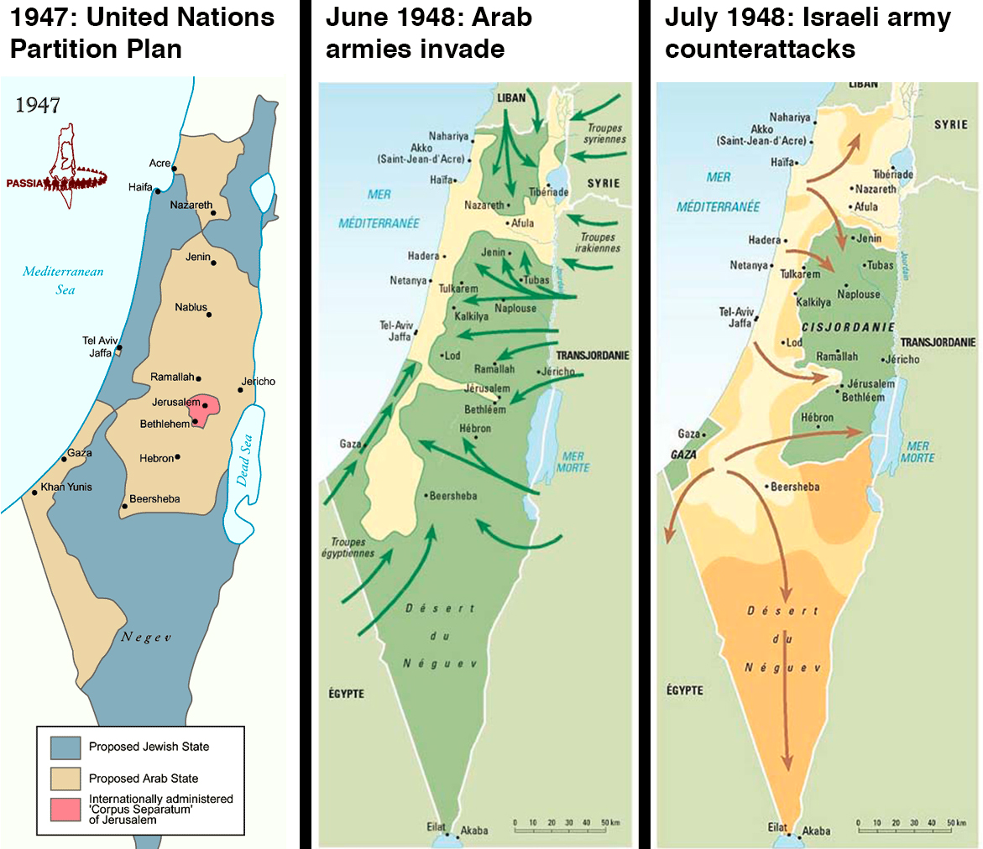
First Arab Israeli War

Slide 28
Israel borders after 1949

Slide 29
Palestinian Loss of Land 1946-2000

Slide 30
1967 War: The Six Day War
May 1967: Arab countries began moving armies close to Israel’s borders.
June 5 Israel launches surprise attack on Egypt.
Syria, Jordan and Iraq joined in fighting Israel.

Slide 31
Results of the 1967 War
Israel captured the West Bank, Gaza Strip, Sinai Peninsula, the Golan Heights and East Jerusalem.
1 million Palestinians came under Israeli military control.
Less than 1,000 Israeli deaths / 20,000 Arab deaths
300,000 more Palestinians became refugees.
Jewish minority communities were expelled from Arab nations.

Slide 32
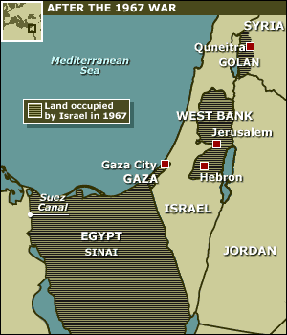
Land occupied by Israel after 1967 War

Slide 33
Human Geography of the Eastern Mediterranean
Society & Culture Today
Arabic is the primary language in the sub region, with Hebrew also spoken in Israel.
Quality of education and health care varies widely from country to country.
Family life usually includes the extended family and often includes religious worship.
In Israel, women generally enjoy equal rights, while in Arabic countries, women’s rights vary greatly.

Slide 35
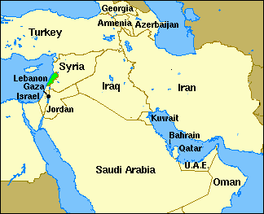
LEBANON

Slide 36
LEBANON
Lebanon was known as the ‘land of milk and honey’. The ‘milk’ came from the snow-covered mountain peaks; the ‘honey’ from the fragrant woods.
Lebanon was mentioned 71 times in the Holy Bible.
King Solomon used only the finest materials in the world to build God's temple in Jerusalem--including the "Cedars of Lebanon." This country of cedars has always served as an important East-West bridge, connecting Europe, Africa, and Asia.

Slide 37
LEBANON GEOGRAPHY
Lebanon lies at the center of the gulf that runs between the Oriental Mediterranean Sea and Turkey and Egypt.
This small country does not exceed 4,036 mi² its length is about 139.8 miles and its width is about 35 miles.
Syria limits Lebanon from the North and the East, and Israel (Palestine) from the South. One range of mountains (Mount Lebanon) leading to an alluvial coastal plain.
At the East, another arid and dry range of mountains lies parallel to the first mountain chain (Anti-Lebanon and Mount Hermon); the two ranges embrace the high plateau of the "Bekaa".

Slide 38
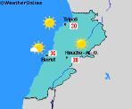
LEBANON CLIMATE
Lebanon has a Mediterranean climate characterized by long, hot, dry summers and short, cool, rainy winters.
The climate is determined by Lebanon's location between the subtropical aridity of the African continent and the subtropical humidity of the eastern Mediterranean area.

Slide 39
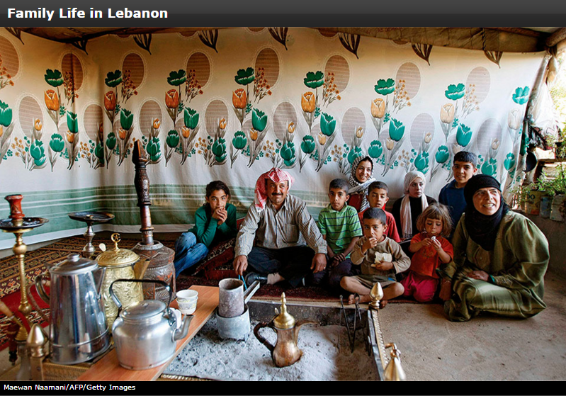

Slide 40
Human Geography of the Eastern Mediterranean
Economic Activities
Economic growth is dependent on agriculture, small deposits of minerals, and manufacturing.
Service industries play a significant role in the sub region's economy, as does tourism, although it can be negatively affected by conflicts and political instability.
Water transportation is vital to the area, with the Strait of Tirān linking the Gulf of Aqaba to the Red Sea.

Slide 41
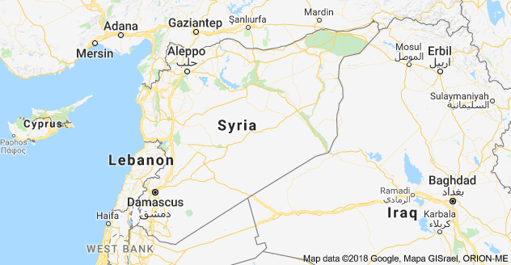
SYRIA

Slide 42
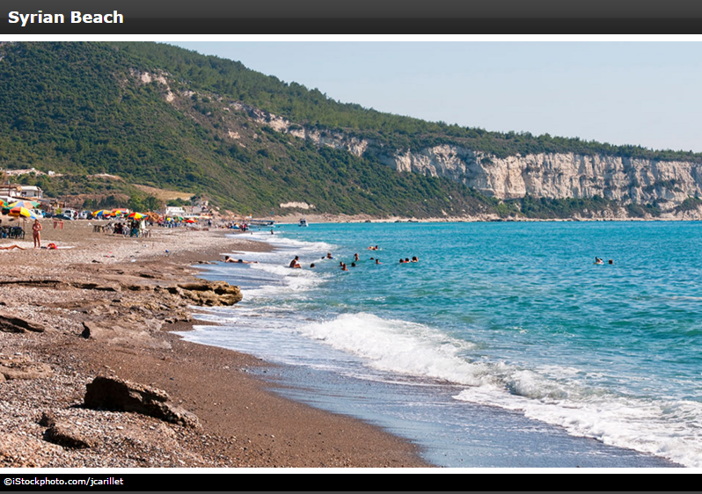

Slide 43
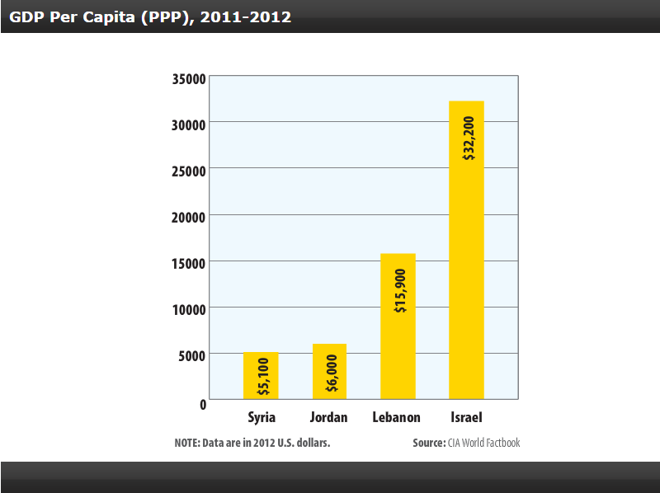

Slide 44
People and Their Environment: the Eastern Mediterranean
Managing Resources
Overfishing, contamination, a rise in sea surface temperatures, and the introduction of invasive species have caused environmental damage to the Mediterranean Sea.
High levels of urbanization and immigration have increased air pollution, which is exacerbated during heat waves.
Bird populations in the sub region also face a serious threat from illegal hunting.

Slide 45
People and Their Environment: the Eastern Mediterranean
Addressing the Issues
Legislation such as the Israeli Clean Air Law has attempted to address environmental issues.
International organizations have been trying to encourage governments to take environmental projects seriously and increase protective legislation.
More work is needed to help alleviate air and water pollution and to stop overfishing.

Slide 46
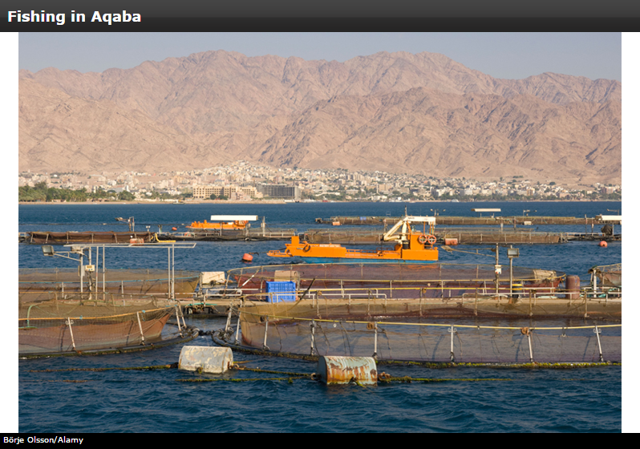

Slide 47
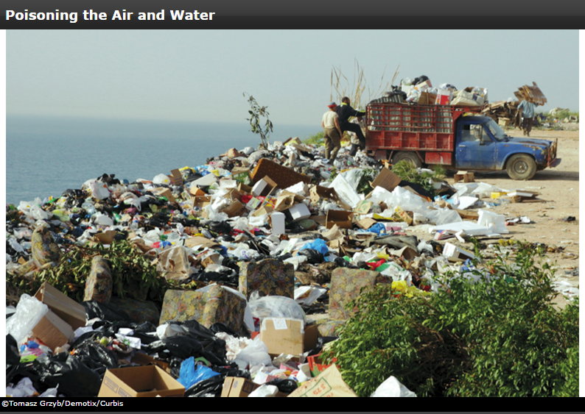
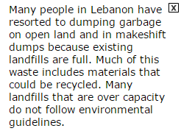

Slide 49
People and Their Environment: the Eastern Mediterranean
Human Impact
Long-term deforestation and desertification, or the process in which arable land becomes desert, are two major problems in the sub region.
Large mammals have become endangered as a result of the destruction of their habitats.
Despite using desalination plants and water recycling programs, Israel will need to find new sources of fresh water as its agricultural sector grows.

Slide 51
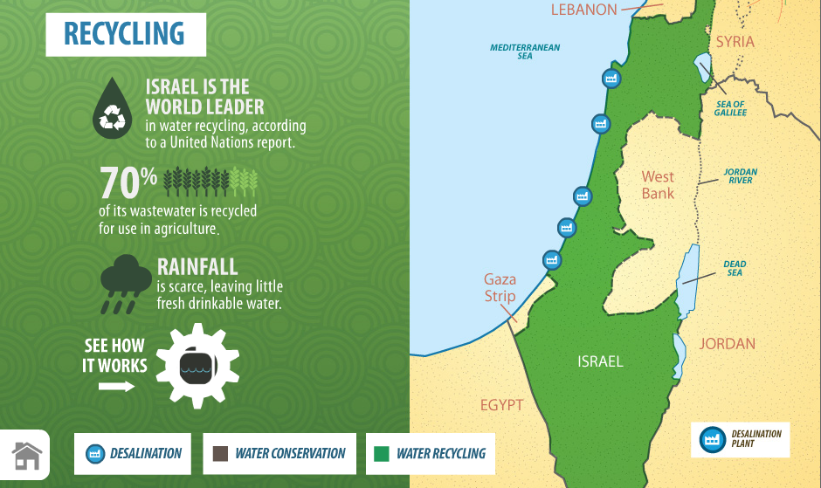

Slide 52
